Slide 1



Advanced Text Analytics . Through NLP and Generative AI .
HICSS-58 Tutorial
Tuesday, 7 January 2025 Room: Kona 4 1:00 – 4:00 p.m. HST

Slide 2
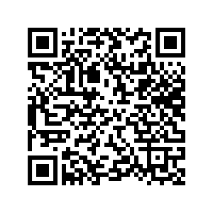
Advanced Text Analytics . Through NLP and Generative AI . .
Please Sign-In (QR Code Sheet Link)
Minitrack on AI Safety, Cybersecurity, and Inclusion Through Advanced Text Analytics Minitrack on Culture, Identity, and Inclusion

Slide 3
Advanced Text Analytics Through NLP and Generative AI
Dr. Derrick L. Cogburn Professor, Information Technology & Analytics, Kogod School of Business
Professor, Environment, Development & Health, School of International Service UNESCO Associate Chair in Transnational Challenges and Governance
Executive Director, Institute on Disability and Public Policy CTRL Faculty Fellow on AI in Teaching and Research
Faculty Director, Internet Governance Lab American University
dcogburn@american.edu Threads: dcogburn@threads.net BlueSky: @derrickcogburn.blsky.social
Haiman Wong Doctoral Student, Doctor of Technology Program Purdue University
Senior Research Associate, Internet Governance Lab American University
wong424@purdue.edu
Minitrack on AI Safety, Cybersecurity, and Inclusion Through Advanced Text Analytics Minitrack on Culture, Identity, and Inclusion
#HICSS_bigdatatext

Slide 4
Tutorial on Advanced Text Analytics with NLP and GenAI
Agenda for the Tutorial: 1:00 – 4:00 p.m.
Welcome, Logistics, and Introductions (1:00-1:10)
Welcome and Logistics
Audience Introductions
Session I: Tutorial Overview/Dataset (1:10-1:15)
Text Mining in R and Python
NIST Cybersecurity RFI Corpus
Session II: Bag of Words Approaches (1:15-1:45)
Keyword and Phrase Frequency
Dictionaries and Sentiment Analysis
Session III: NLP-Syntactic Parsing and Unsupervised Machine Learning Approaches (1:45-2:15)
Named Entity Recognition
Topic Modeling
Coffee Break 2:15 – 2:45
Session IV: Supervised Machine Learning: Classification and Regression (2:45-3:15)
Predictive Models – Classification
Predictive Models – Regression
Session V: Generative AI and RAG (3:15-3:45)
Prompt Engineering
Notebook LM/AI Studio
Wrap-up, Discussion, Next Steps (3:45 – 4:00)
HICSS Community on Text Analytics

Slide 5
Tutorial on Advanced Text Analytics with NLP and GenAI
Agenda for the Tutorial: 1:00 – 4:00 p.m.
Welcome, Logistics, and Introductions (1:00-1:10)
Welcome and Logistics - DLC
Audience Introductions - HW
Session I: Tutorial Overview/Dataset (1:10-1:15)
Text Mining in R and Python - DLC
NIST Cybersecurity RFI Corpus - HW
Session II: Bag of Words Approaches (1:15-1:45)
Keyword and Phrase Frequency – JW/MA
Dictionaries and Sentiment Analysis – JW
Session III: NLP-Syntactic Parsing and Unsupervised Machine Learning Approaches (1:45-2:15)
Named Entity Recognition - HW
Topic Modeling - DLC
Coffee Break 2:15 – 2:45
Session IV: Supervised Machine Learning: Classification and Regression (2:45-3:15)
Predictive Models – Classification - TAO
Predictive Models – Regression - TAO
Session V: Generative AI and RAG (3:15-3:45)
Prompt Engineering - DLC
Notebook LM/AI Studio - DLC
Wrap-up, Discussion, Next Steps (3:45 – 4:00)
HICSS Community on Text Analytics - HW

Slide 6
Welcome, Logistics, and Introductions .
HICSS-58 Tutorial
Tuesday, 7 January 2025 Room: Kona 4 1:00 – 4:00 p.m. HST

Slide 7




My Background: Derrick Cogburn
My Family
Dr. Noemi Enchautegui-de-Jesus
Sean Manuel Cogburn-Enchautegui
Dr. Courtney Dawn Cogburn
Academic Organizations
American University (current)
School of International Service
International Communication
Kogod School of Business
Information Technology and Analytics
Syracuse University (former)
School of Information Studies
Burton Blatt Institute
University of Michigan (former)
School of Information
Center for Research on e-Work
Government and Private Research
CSIS – GIIC
CSIR – South Africa
CRS – Congressional Research Service
International Organizations
World Bank
UNECA
UNESCAP
UN GAID
Research Funding
National Science Foundation
The Nippon Foundation
JPMorgan Chase
WK Kellogg Foundation
Microsoft Research
Hewlett-Packard
Teaching Data Analytics
Big Data and Text Analytics (grad)
R, Python, Provalis
Business Analytics (MS)
AI Principles and Techniques
R; Python, GenAI Tools

Slide 8


My Background: Haiman Wong
Senior Research Associate, Internet Governance Lab, American University
Doctoral Candidate at Purdue University’s Doctor of Technology (DTECH) program
Research interests center on the intersection:
internet governance,
rhetoric, natural language processing, technology innovation and leadership, political science, and law
A “Double Eagle” alumna of American University:
B.A. in Communications, Legal Institutions, Economics, and Government from the School of Public Affairs (SPA)
M.S. in Data Science with a concentration in Cybersecurity from the College of Arts and Sciences (CAS)
Experience spans across the financial, education, and technology industries:
worked in data science, global cybersecurity risk and threat intelligence management, cybersecurity incident response, and digital transformation

Slide 9
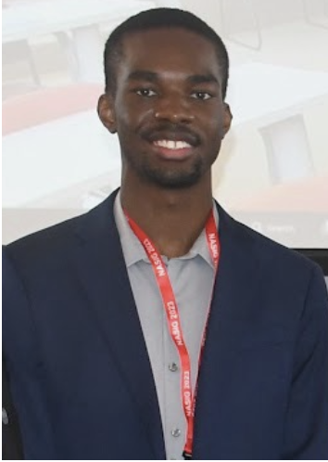


Our Remote Researchers and Presenters
Theodore “Andrew” Ochieng, Senior Research Associate, is a graduate of the Analytics Master’s Program at the Kogod School of Business at American University. He has several years of experience helping organizations leverage data to solve problems by increasing data utility through supporting various stages of the analytics and modeling pipeline such as improving ETL pipelines, data cleaning, feature engineering, and developing and deploying models. His work spans across the cybersecurity, software-as-a-service (SaaS), education, and policy research sectors where he worked in data science, market and competitive intelligence, and research and strategy analysis.
Sierra Buehlman Barbeau recently completed law school at American University, focusing on environmental law, sustainable development, and ESG. She is also obtaining her master’s degree from American University’s School of International Service. Her research interests and real-world endeavors involve integrating text mining research with legal research for several environmentally-focused organizations. She is leading our team’s focus on evaluating the SDGs using advanced text analytics.
Juliana Woods is a Graduate Research Assistant at the American University Institute on Disability and Public Policy (IDPP). She is currently a Master’s Candidate in the American University School of International Service International Affairs Policy and Analysis Program. She earned her B.A. in Anthropology with a minor in International Development and Conflict Management from University of Maryland College Park in 2022. Her research and work within IDPP centers around examining state parties’ implementation of the CRPD in the past and present, promoting the research of IDPP online, and overseeing the center’s website and social media presence.

Slide 10
Tutorial on Advanced Text Analytics with NLP and GenAI
Participant Summary
How many of you:
are faculty?
are doctoral students?
are graduate students?
new to HICSS?
veterans of HICSS (5 or more)?
have used commercial text mining software?
have used R or Python for text mining/NLP?
teach text mining/NLP?
published research using text mining/NLP?

Slide 11
Session I: Tutorial Overview and Dataset .
HICSS-58 Tutorial
Tuesday, 7 January 2025 Room: Kona 4 1:00 – 4:00 p.m. HST

Slide 12
Tutorial on Advanced Text Analytics with NLP and GenAI
Agenda for the Tutorial: 1:00 – 4:00 p.m.
Welcome, Logistics, and Introductions (1:00-1:10)
Welcome and Logistics
Audience Introductions
Session I: Tutorial Overview/Dataset (1:10-1:15)
Text Mining in R and Python
NIST Cybersecurity RFI Corpus
Session II: Bag of Words Approaches (1:15-1:45)
Keyword and Phrase Frequency
Dictionaries and Sentiment Analysis
Session III: NLP-Syntactic Parsing and Unsupervised Machine Learning Approaches (1:45-2:15)
Named Entity Recognition
Topic Modeling
Coffee Break 2:15 – 2:45
Session IV: Supervised Machine Learning: Classification and Regression (2:45-3:15)
Predictive Models – Classification
Predictive Models – Regression
Session V: Generative AI and RAG (3:15-3:45)
Prompt Engineering
Notebook LM/AI Studio
Wrap-up, Discussion, Next Steps (3:45 – 4:00)
HICSS Community on Text Analytics

Slide 13


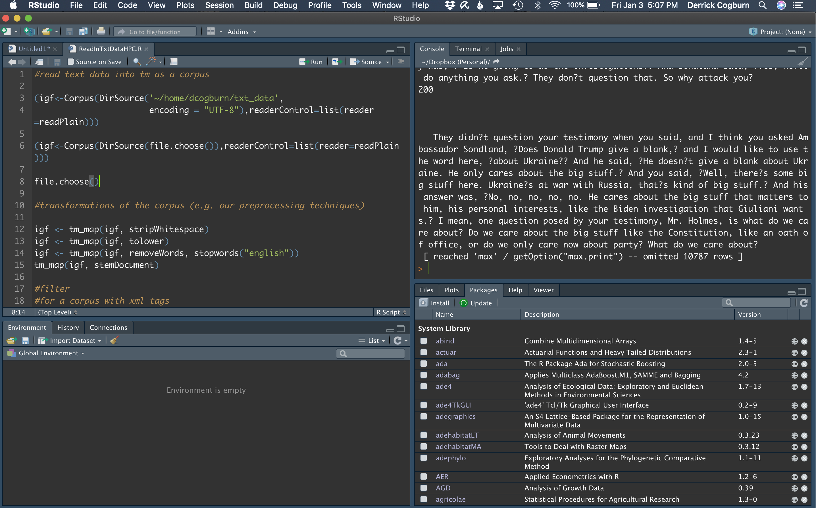
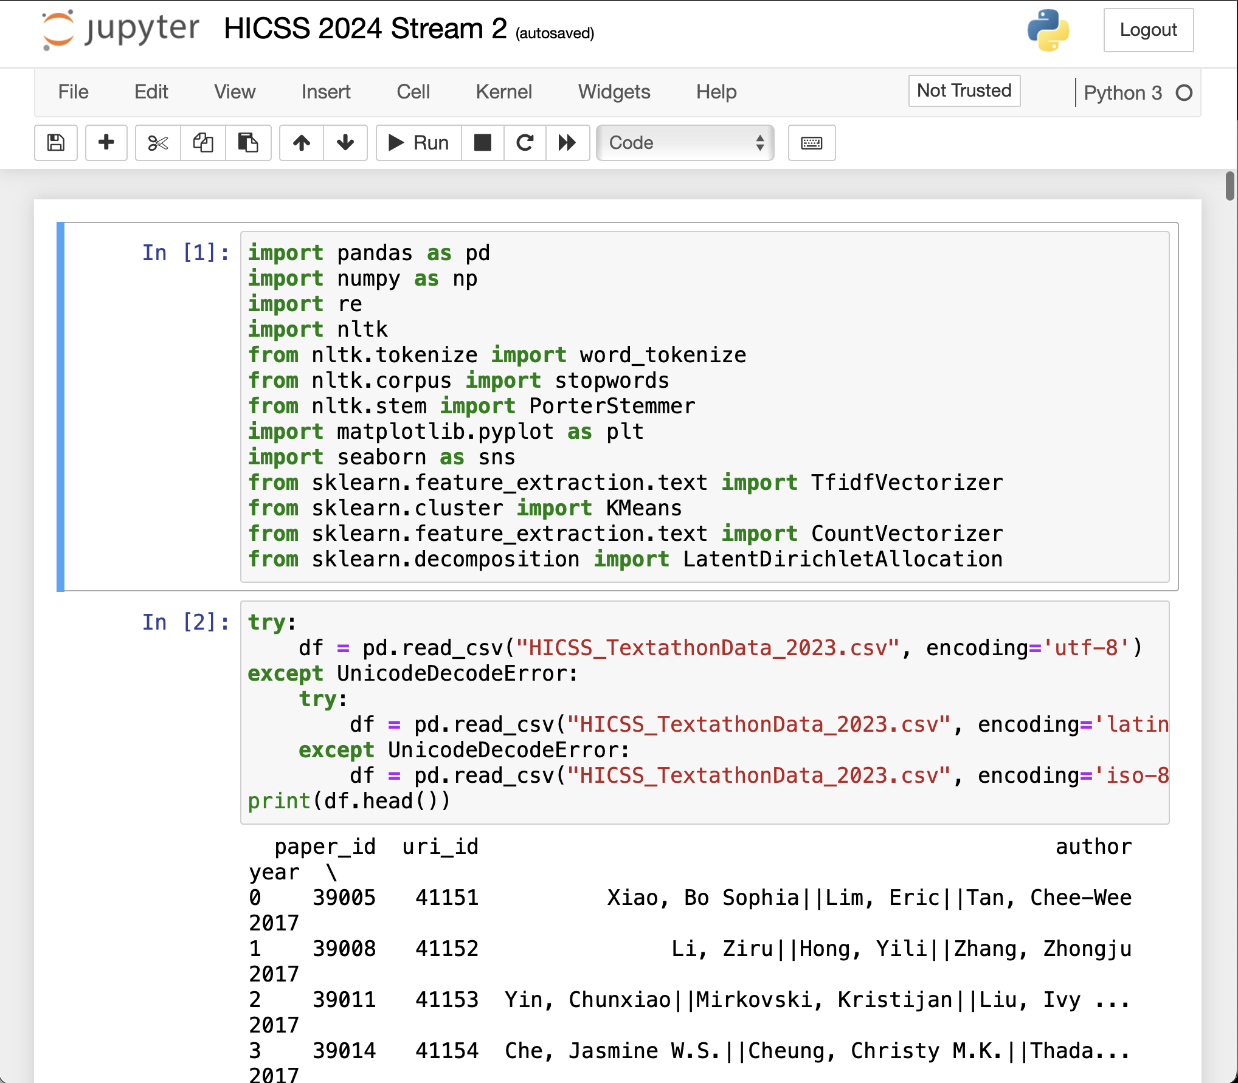

Demonstrations of Text Mining with R and Python in RStudio, Positron, and Jupyter Notebooks

Slide 14
Tutorial on Advanced Text Analytics with NLP and GenAI
Learning Objectives
At the end of this tutorial, participants should be able to:
Understand the wide range of text mining approaches in big data analytics
Identify a range of tools (commercial and open source) appropriate for text mining
Understand some of the challenges faced when doing more advanced text analytics
Identify various strategies and techniques to deal with text analysis challenges
Identify exploratory and confirmatory text mining techniques and when to apply
Recognize some strengths and weaknesses of selected text mining techniques
Understand basics of prompt engineering and use of GenAI for text analytics
Identify key aspects of the NIST AI and Cybersecurity RFI dataset

Slide 15
Tutorial on Advanced Text Analytics with NLP and GenAI
Agenda for the Tutorial: 1:00 – 4:00 p.m.
Welcome, Logistics, and Introductions (1:00-1:10)
Welcome and Logistics
Audience Introductions
Session I: Tutorial Overview/Dataset (1:10-1:15)
Text Mining in R and Python
NIST Cybersecurity RFI Corpus
Session II: Bag of Words Approaches (1:15-1:45)
Keyword and Phrase Frequency
Dictionaries and Sentiment Analysis
Session III: NLP-Syntactic Parsing and Unsupervised Machine Learning Approaches (1:45-2:15)
Named Entity Recognition
Topic Modeling
Coffee Break 2:15 – 2:45
Session IV: Supervised Machine Learning: Classification and Regression (2:45-3:15)
Predictive Models – Classification
Predictive Models – Regression
Session V: Generative AI and RAG (3:15-3:45)
Prompt Engineering
Notebook LM/AI Studio
Wrap-up, Discussion, Next Steps (3:45 – 4:00)
HICSS Community on Text Analytics

Slide 16
Session I: Overview of Text .. Analytics Tutorial and Dataset .
HICSS-58 Tutorial
Tuesday, 7 January 2025 Room: Kona 4 1:00 – 4:00 p.m. HST

Slide 17
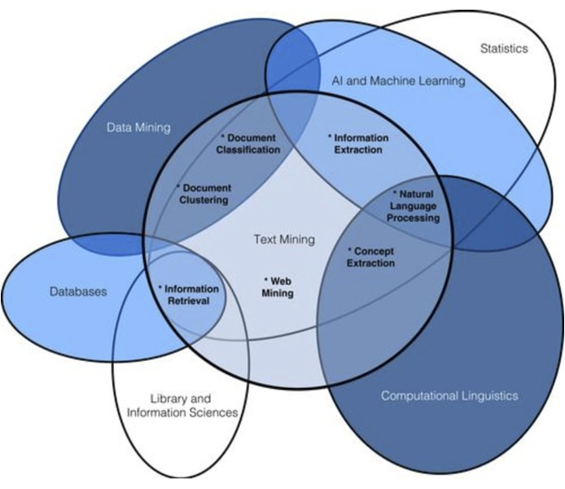
Text Mining in the World of Data Science
Source: Practical Text Mining, Miner (2012)

Slide 18
Potential of Text in Big Data Analytics
Use of the Internet, World Wide Web and applications from email, social media, blogs, etc. create voluminous amounts of digital text data (e.g. Public Diplomacy, Open Data, Data.Gov).
Digitization made it easier for computers to access, read, store and process
Mobile computing is accelerating these processes
Data Integration Example of Peapod and Giant “Bonus” Card
Data Collection and Democratization APIs and Scraping tools
Analytical tools, such as Hadoop/MapReduce, R and Python, making it easier to handle large scale analysis of heterogeneous and unstructured digital data
These techniques were once only the purview of intelligence agencies and large corporations

Slide 19

Key Approaches/Techniques in Text Mining
Inductive (exploratory)
Descriptive analysis
Key words
Key phrases
Named Entity Recognition
People, Places, Acronyms, Organizations, Currency
Unsupervised Machine Learning
Topic Modeling
String Distance
Clustering
Deductive (confirmatory)
Cross-Tabulation/Sub-Group Comparisons with Key Variables
Categorization Models
Dictionary Use and Development, including Sentiment Analysis
Classification Models
Supervised Machine Learning

Slide 20
Text Mining Tools (Commercial and Open Source)
Commercial tools
Provalis ProSuite, IBM Text Modeler for Text, IBM Watson, SAS Text Miner, Clarabridge, Lexalytics, AlchemyAPI, Attensity, Enkata, OdinText
Open-source tools
R/RStudio, Python (both with numerous packages and libraries for text mining and NLP)
Gensim, Mallet, Rapid Miner, Gate, KNIME
NLP Libraries
Stanford NLP, Natural Language Tookit (NLTK), OpenCalais, Apache OpenNLP, etc.

Slide 21
Setting Up Your R Environment
R Project
http://www.r-project.org
Comprehensive R Archive Network (CRAN)
CRAN Mirror Sites
Basic R Install
Windows: RGui
Mac OSX: R.app
Linux: (none; can use Emacs, Vim, or any other)
Practically: OS doesn’t matter; R functions the same across all systems
Help with install
Mac: http://vimeo.com/36697971
Windows: http://tinyurl.com/872ngtt

Slide 22
Setting Up Your R Development Environment
RStudio
Third party Integrated Development Environment (IDE) for R, provides consistent user interface regardless of OS
Free: (Windows, Linux, Mac); Bundled with RInstructor (iOS)
https://www.rstudio.com/ (NB: Remember R, must be installed first)

Slide 23

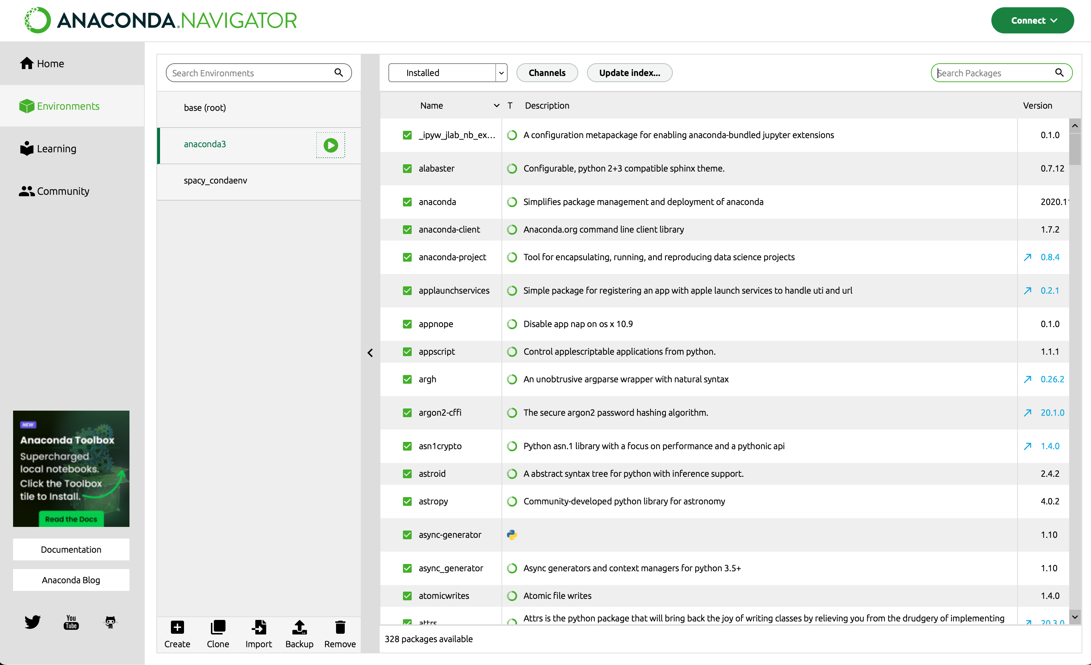
Setting Up Your Python Environment
Python
https://www.python.org
Anaconda (distribution of Python)
https://www.anaconda.com
Python Package Index (PyPi)
https://pypi.org
Basic Python Install (3.x not 2.x)
Anaconda/conda (anaconda.com)
Python.org
Practically: OS doesn’t matter; Python functions the same across most operating systems

Slide 24
Setting Up Your Python Development Environment
For Python Development:
Editor (IDE)
Interpreter
Packages
Editors
Jupyter Notebook (Julia, Python, R)
VS Code
Ipython
RStudio (Reticulate, quarto, RMD)

Slide 25

Git and GitHub: Distributed Collaboration in Coding
What is Git?
A free, open source, distributed, Version Control System (VCS)
Software designed to record changes to a file over time, which allows you to track changes, and revert to previous versions
Compare changes (v1, v2, v3…)
Which changes, when, who, and why?
What is GitHub
A collaboration platform built on top of Git
Largest community of software developers in the world (31M)
Designed to foster a community of developers
Create, share, and grow a development community
Issues
Pull requests
Projects
Organizations and Teams
Accessing Your Tutorial Scripts via Private GitHub Repository:
Create free github account (send me your username)
I will add you to the private repo for the workshop
http://github.com

Slide 26
Tutorial on Advanced Text Analytics with NLP and GenAI
Recommended Reading
Text Mining with R: A Tidy Approach, Julia Silge & David Robinson, O’Rielly, 2017 (Kindle, and free online)
R for Data Science: Import, Tidy, Transform, Visualize, and Model Data (2nd Edition). Hadley Wickham and Garrett Grolemund, O’Reilly Media, 2023 (Kindle, and free online)
Supervised Machine Learning for Text Analysis in R, Emil Hvitfeldt and Julia Silge, CRC Press, Taylor & Francis 2022 (Kindle, and free online).
Text as Data: A New Framework for Machine Learning in the Social Sciences, Justin Grimmer, Margaret E. Roberts, Brandon M. Stewart, Princeton University Press, 2022 (Kindle)
Python and R for the Modern Data Scientist: The Best of Both Worlds, Rick J. Scavetta and Boyan Angelov, O’Reilly, 2021, and free online)
Text Analytics with Python: A Practitioner’s Guide to Natural Language Processing, 2nd Edition, Dipanjan Sarkar, Apress, 2019
Deep Learning with R, François Chollet, Manning, 2018 (Kindle)
Practical Text Mining and Statistical Analysis, Gary Miner et al, Academic Press (2012) (Kindle)
Tidy Modeling with R: A Framework for Modeling in the Tidyverse. Max Kuhn & Julia Silge, O’Reilly, 2022 (Kindle, and free online, see Canvas)
Practical Text Analytics: Interpreting Text and Unstructured Data for Business Intelligence. Steven Struhl Kogan Page Limited, 2015 (Kindle)

Slide 27
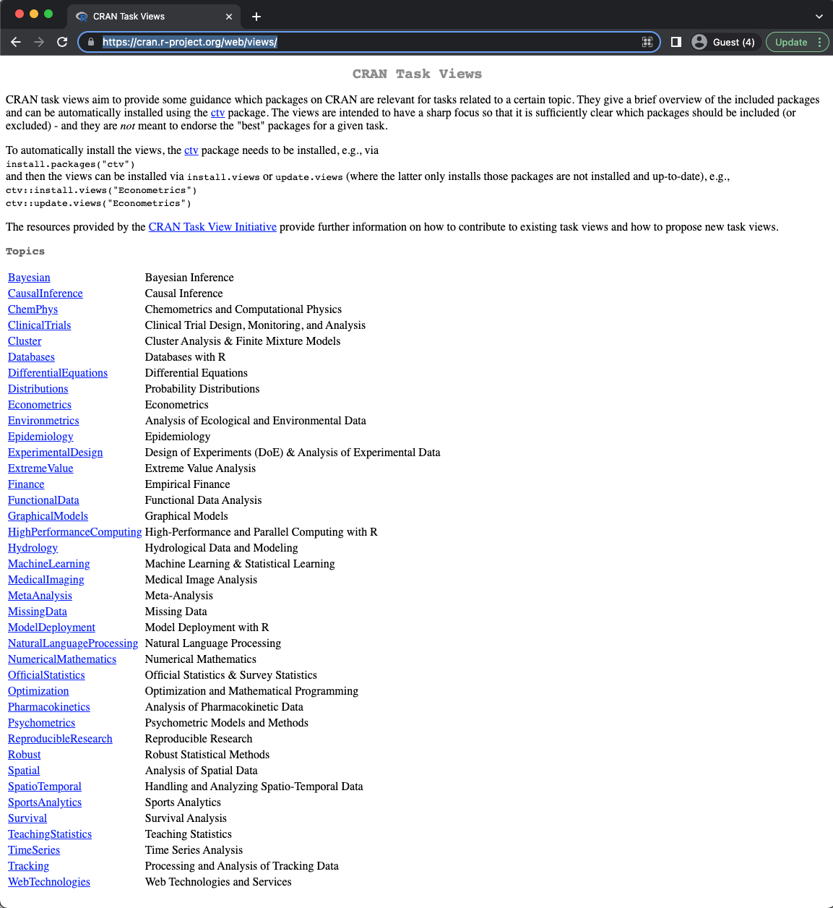
Finding, Installing, Learning, and Using Packages in R
Finding Packages
https://cran.r-project.org/web/views/
https://support.rstudio.com/hc/en-us/articles/201057987-Quick-list-of-useful-R-packages
Installing Packages
install.packages(“packageName”)
Learning Packages
Package Vignettes
Package Websites
Using Packages
library(packageName)

Slide 28
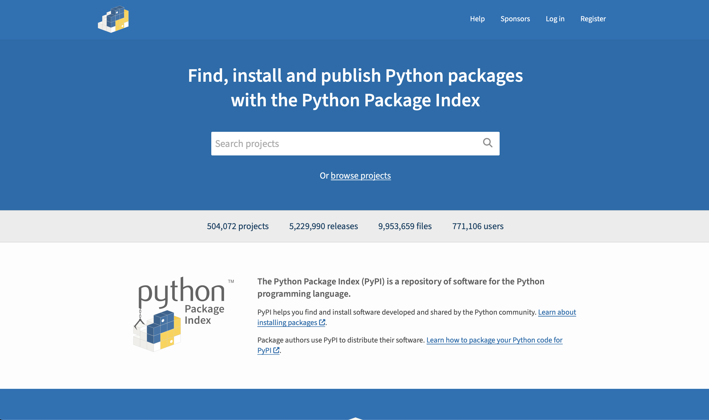
Finding, Installing, Learning, and Using Python Packages
Python Package Index (PyPi)
https://pypi.org
Installing Packages
Anaconda
Interpreter prompt >>>
pip install packageName
Learning Packages
Package Vignettes
Package Websites
Using Packages
import pandas as pd

Slide 29
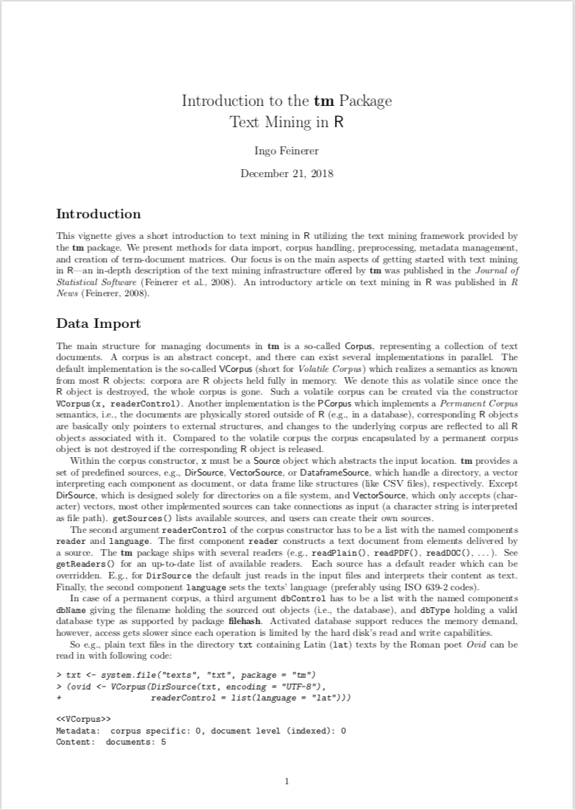
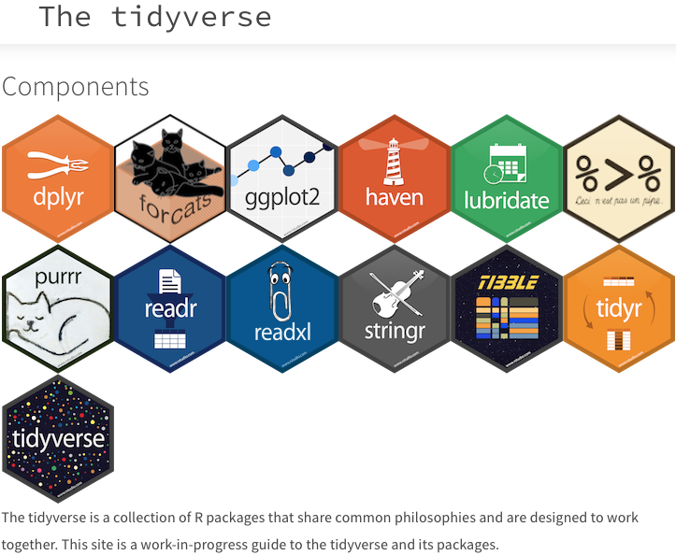


Tools for Text Mining in R: An Ecosystem Overview
tm
Tidytext
quanteda
Reticulate:
A comprehensive set of tools to provide interoperability between R and Python

Slide 30










Tools for Text Mining in Python: An Ecosystem Overview
nltk
spaCy
gensim
textblob
Machine Learning
ScikitLearn
NumPy
SciPy
PyTorch
TensorFlow
Keras

Slide 31

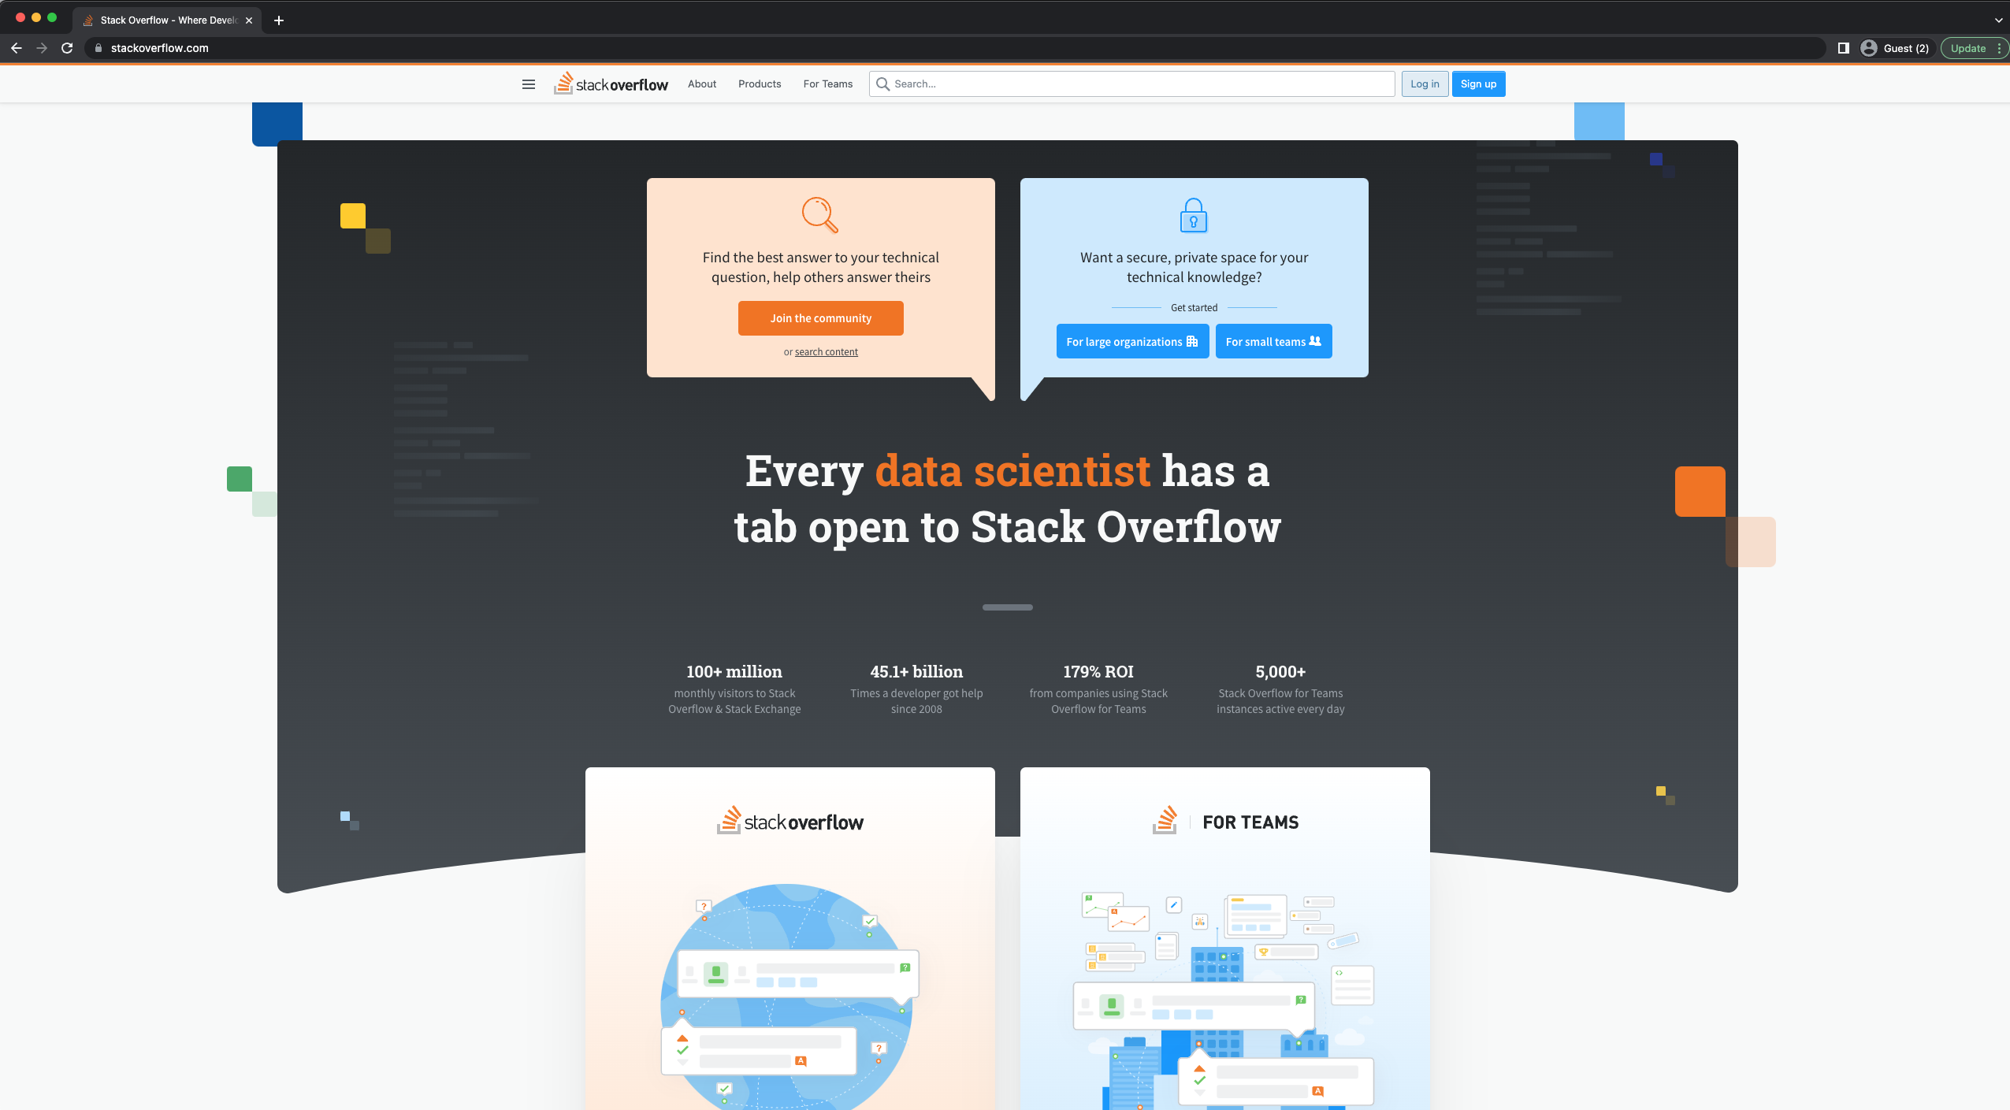
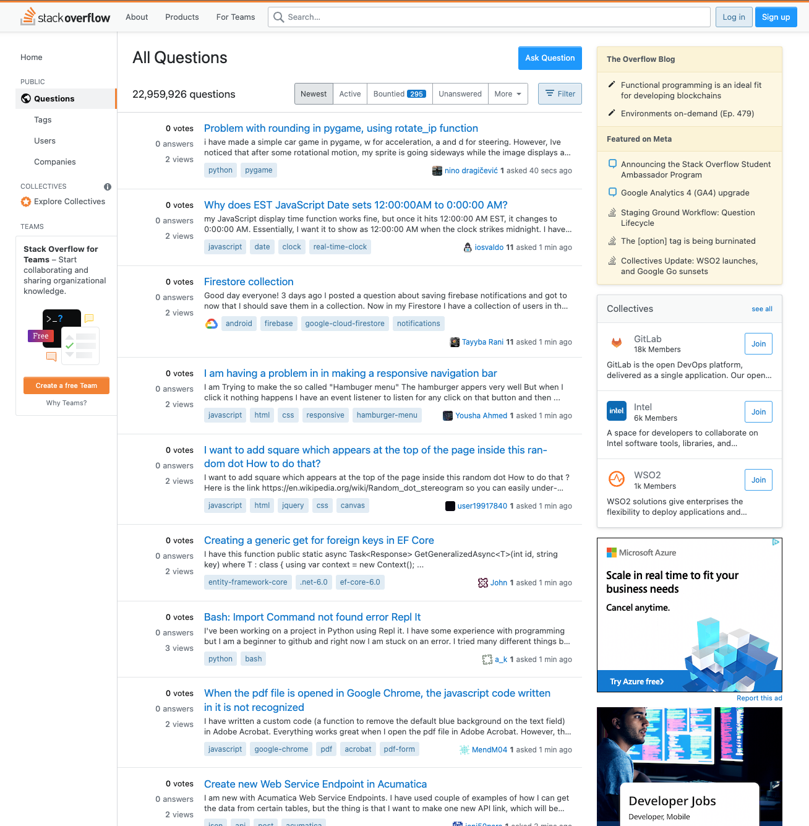
Troubleshooting
Stackoverflow
Q&A Site
https://stackoverflow.com/questions
Specific sub-sites for r and python
https://stackoverflow.com/questions/tagged/r
https://stackoverflow.com/questions/tagged/python
Specific sub-site for quanteda and nltk
https://stackoverflow.com/questions/tagged/quanteda
https://stackoverflow.com/questions/tagged/nltk
Best Practices
Read/study first; ask well formulated questions later…

Slide 32


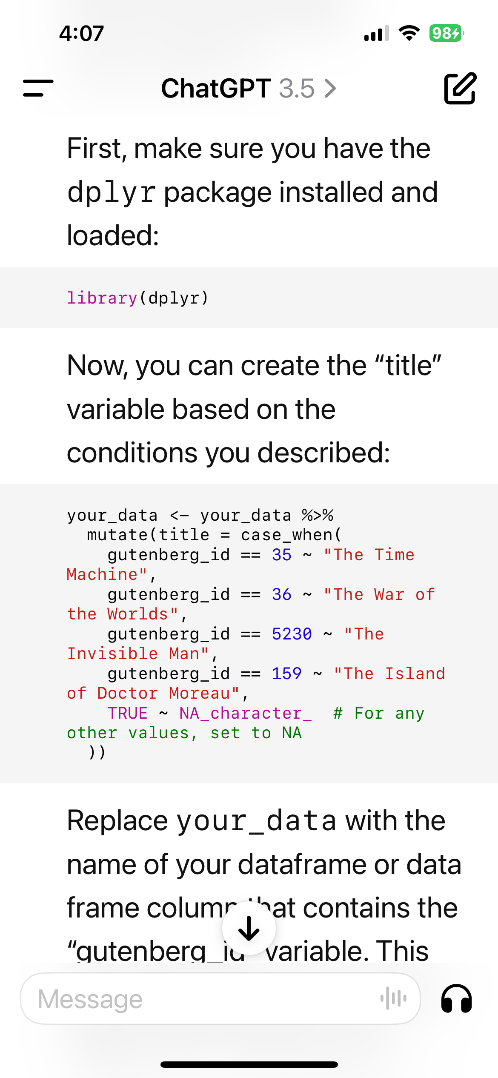
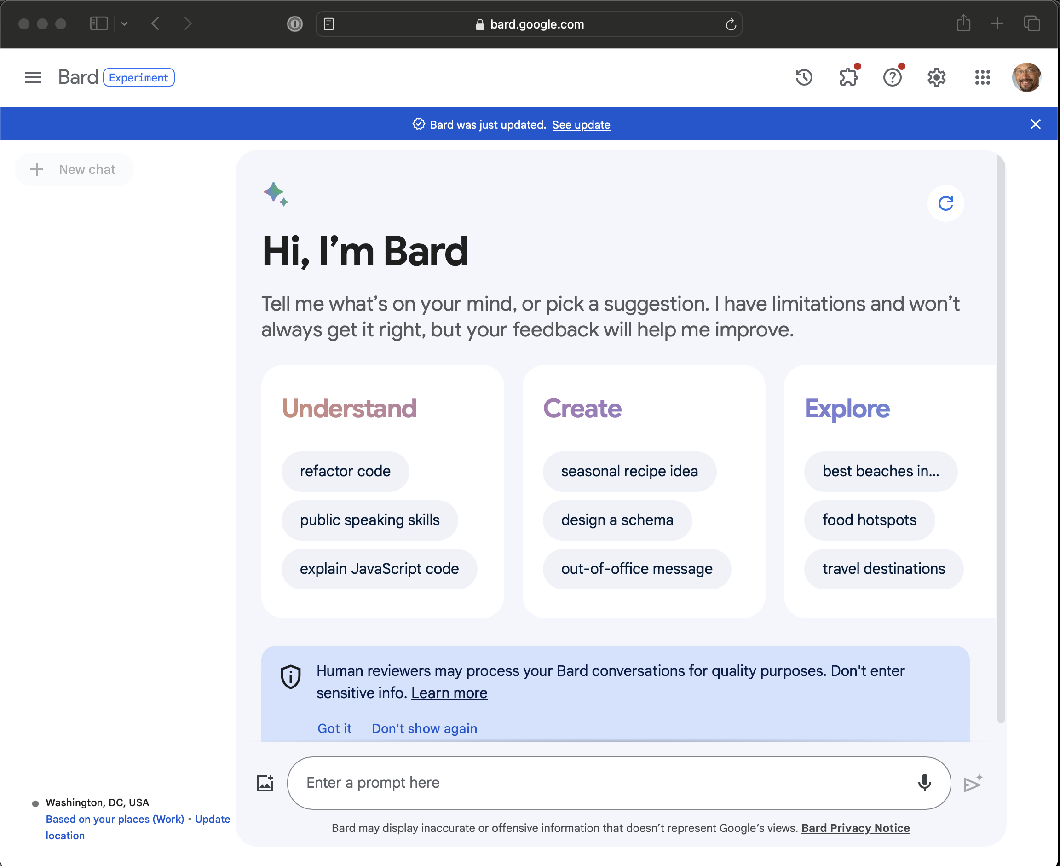

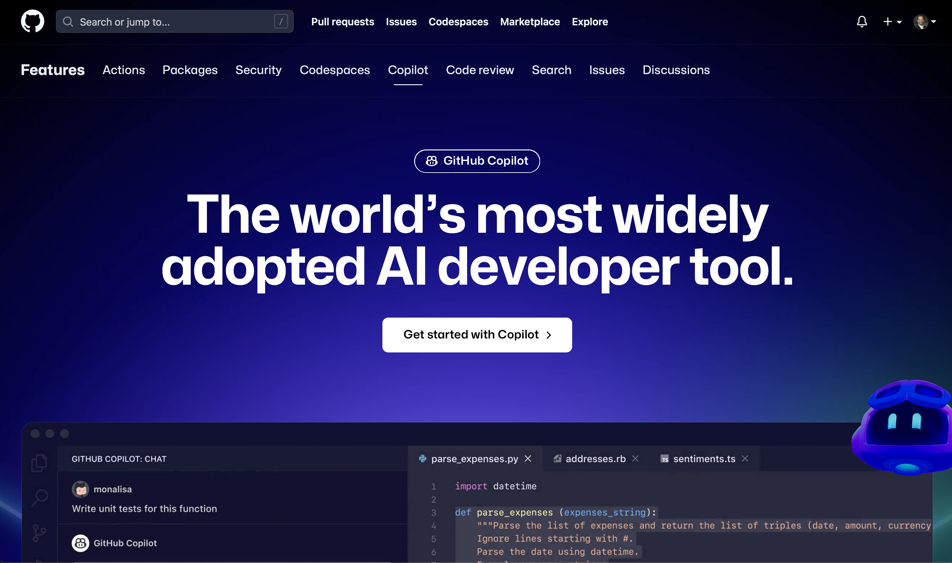
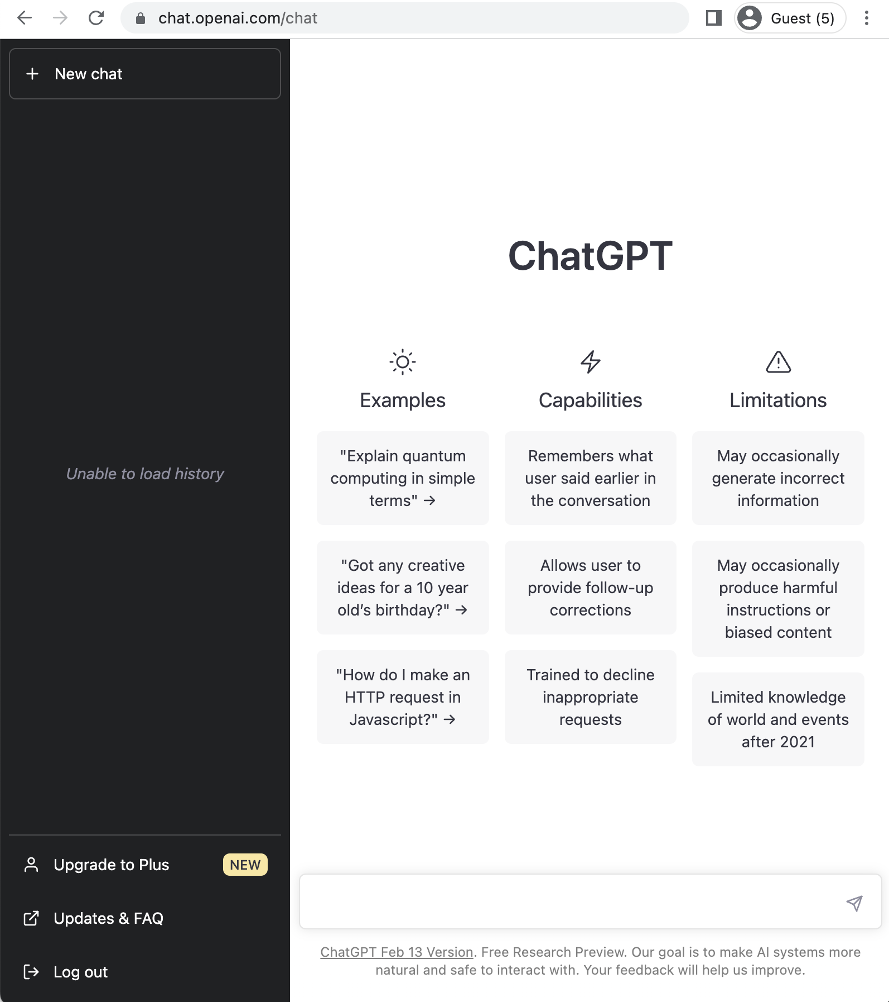
Use of GenAI Tools for Troubleshooting
Large Language Models (LLMs) are trained on very large textual datasets. Google’s DeepMind, Meta AI, and other corporate AI labs battle in the creation and application of Generative Pre-Trained Transformers (GPT), a LLM designed to understand text inputs and generate human-like language responses. Led to the creation of OpenAI (2015). Google’s BERT (Bi-Directional Encoder Responses from Transformers) model is an example (2017). OpenAI launched ChatGPT (2022): An AI chatbot based on GPT. While difficult to get accurate information on training data, GPT-1 120 million parameters; GPT-2 1.5 billion parameters; GPT-3 175 billion parameters (up to September 2021); GPT-4 1.7 trillion parameters. Requires enormous data and GPU computing power.
https://bard.google.com
https://github.com/features/copilot
https://chat.openai.com/
Notes:
No easy task; multiple definitions and considerations (e.g. what is intelligence).

Slide 33
The NIST Cybersecurity RFI Corpus
The NIST Cybersecurity RFIs (Requests for Information) from 2021 (N=130) are documents issued by the National Institute of Standards and Technology (NIST) to gather feedback and recommendations from stakeholders on cybersecurity-related topics. These RFIs serve as part of NIST’s efforts to engage with industry, academia, government, and the public to refine cybersecurity frameworks, guidelines, and initiatives.
Purpose:
Solicit stakeholder input on specific cybersecurity topics.
Inform updates to the NIST Cybersecurity Framework (CSF) and related guidance.
Identify emerging trends, challenges, and needs in cybersecurity.
Content Types:
Open-ended questions seeking qualitative responses.
Technical recommendations and policy suggestions from respondents.
Discussions of best practices, challenges, and success stories in cybersecurity.
Respondents:
Private sector organizations (e.g., tech companies, consultants).
Public sector entities (e.g., federal agencies, local governments).
Academic and research institutions.
Civil society groups and individual contributors.
Structure:
Typically structured around themes, such as risk management, incident response, emerging technologies, and privacy considerations.
Responses can include narrative text, bullet points, tables, or technical specifications.
Volume of Data:
The RFI received over 130 responses, resulting in a rich corpus of text data for analysis.
Responses vary in length and detail, from brief comments to lengthy technical reports.

Slide 34
The NIST Cybersecurity RFI Corpus
Topics and Themes:
The data contains insights into critical cybersecurity issues, including:
Risk assessment and management practices.
Strategies for securing critical infrastructure.
Adoption of emerging technologies like AI, IoT, and quantum computing.
Compliance with evolving regulations and standards.
Stakeholder Perspectives:
The responses reveal varying priorities and concerns across sectors, reflecting the diverse impact of cybersecurity issues.
Policy and Technical Recommendations:
The data offers practical guidance and innovative ideas that can inform policy and research.

Slide 35
The NIST Cybersecurity RFI Corpus
Unstructured Data:
Responses are often in free-text format, requiring preprocessing for analysis.
Diversity of Language:
Technical jargon, legal terminology, and plain language may coexist, necessitating careful NLP techniques.
Volume:
Handling and analyzing large datasets from these RFIs may require efficient computational methods.
The NIST Cybersecurity RFI Corpus is ideal for thematic analysis, topic modeling, sentiment analysis, and comparative studies to understand the evolution of cybersecurity concerns and stakeholder priorities.

Slide 36
Tutorial on Advanced Text Analytics with NLP and GenAI
Agenda for the Tutorial: 1:00 – 4:00 p.m.
Welcome, Logistics, and Introductions (1:00-1:10)
Welcome and Logistics
Audience Introductions
Session I: Tutorial Overview/Dataset (1:10-1:15)
Text Mining in R and Python
NIST Cybersecurity RFI Corpus
Session II: Bag of Words Approaches (1:15-1:45)
Keyword and Phrase Frequency
Dictionaries and Sentiment Analysis
Session III: NLP-Syntactic Parsing and Unsupervised Machine Learning Approaches (1:45-2:15)
Named Entity Recognition
Topic Modeling
Coffee Break 2:15 – 2:45
Session IV: Supervised Machine Learning: Classification and Regression (2:45-3:15)
Predictive Models – Classification
Predictive Models – Regression
Session V: Generative AI and RAG (3:15-3:45)
Prompt Engineering
Notebook LM/AI Studio
Wrap-up, Discussion, Next Steps (3:45 – 4:00)
HICSS Community on Text Analytics

Slide 37
Session II: Bag of Words (BOW) . Text Analytics Approaches .
HICSS-58 Tutorial
Tuesday, 7 January 2025 Room: Kona 4 1:00 – 4:00 p.m. HST

Slide 38
Statistical Text Mining v. Natural Language Processing
Statistical Text Mining
Takes a “bag of words” approach
Creates a numerical representation of the corpus
Contributes to techniques such as keyword and phrase frequency analysis, topic modeling, data manipulation and most other statistically based analyses
Natural Language Processing
Usually begins by parsing text and parts of speech tagging
Contributes to techniques such as Named Entity Recognition

Slide 39
The “Bag of Words” Assumption
The “bag of words” assumption
An assumption made by the vector-space model that the order of the words in the document does not matter
While a “big assumption” text mining experts have found that they can still differentiate between semantic concepts by using all the words in the documents
Bag of Words assumptions do not work in all situations and some information extraction tasks and natural language processing (NLP) relies heavily on the words themselves (e.g. part of speech tagging) and the order of the words (preceding and following)
Specialized NLP algorithms are used in these cases

Slide 40
Tokenization
A token is a meaningful unit of text (e.g. character, word, sentence, or paragraph). To “tokenize” a text, you do so by selecting the unit that is most meaningful to you for your analysis.
Parsing/separating text into meaningful “chunks”
May tokenize by “character” – not necessarily useful
May tokenize by “word” – most frequent starting point
May tokenize by “n-grams” – 2-x word phrases
May tokenize by “sentences” – helpful in some analyses
May tokenize by “paragraphs” – helpful in some analyses

Slide 41
Frequency Analysis
Count-based evaluation
One of the simplest analyses methods, but widely used
A “frequent” term is deemed “important”
Easily interpretable, and computationally inexpensive
Word frequencies, and “phrase” frequencies (n-grams)
Creation of a term-document matrix
Represents the corpus in form of a matrix with documents as rows and terms as columns
You may also use the ”heuristic” of TF*IDF
Term frequency by inverted document frequency to identify “important” words

Slide 42
Text Mining in R: An Ecosystem Overview
tm
Tidytext
quanteda

Slide 43
The Tidyverse
Designed by RStudio, led by Chief Data Scientist Hadley Wickham. The tidyverse includes a collection of versatile packages that are engineered to work together very closely, easily passing data into and out of each package, to transform how data scientists use R for analytics. The packages contained in the tidyverse are:
ggplot2 (visualization),
dplyr (manipulation),
tidyr (creating tidy datasets),
readr (rread in rectangular data),
purrr (functional programming),
tibble (a modern re-imagining of the data frame),
stringr (string - text - manipulations),
forcats (solves problems with categorical variables.
The packages of the tidyverse are all are designed to work together very closely. The multiple components of the tidyverse are illustrated below in Figure 1. using the now familiar R hexagonal icons.

Slide 44
The Tidyverse
Figure 1. Key Components of the RStudio Tidyverse

Slide 45

dplyr
dplyr is a grammar of data manipulation, providing a consistent set of verbs that help you solve the most common data manipulation challenges:
mutate() adds new variables that are functions of existing variables
select() picks variables based on their names.
filter() picks cases based on their values.
summarise() reduces multiple values down to a single summary.
arrange() changes the ordering of the rows.
These all combine naturally with group_by() which allows you to perform any operation “by group”. You can learn more about them in vignette("dplyr"). As well as these single-table verbs, dplyr also provides a variety of two-table verbs, which you can learn about in vignette("two-table").

Slide 46
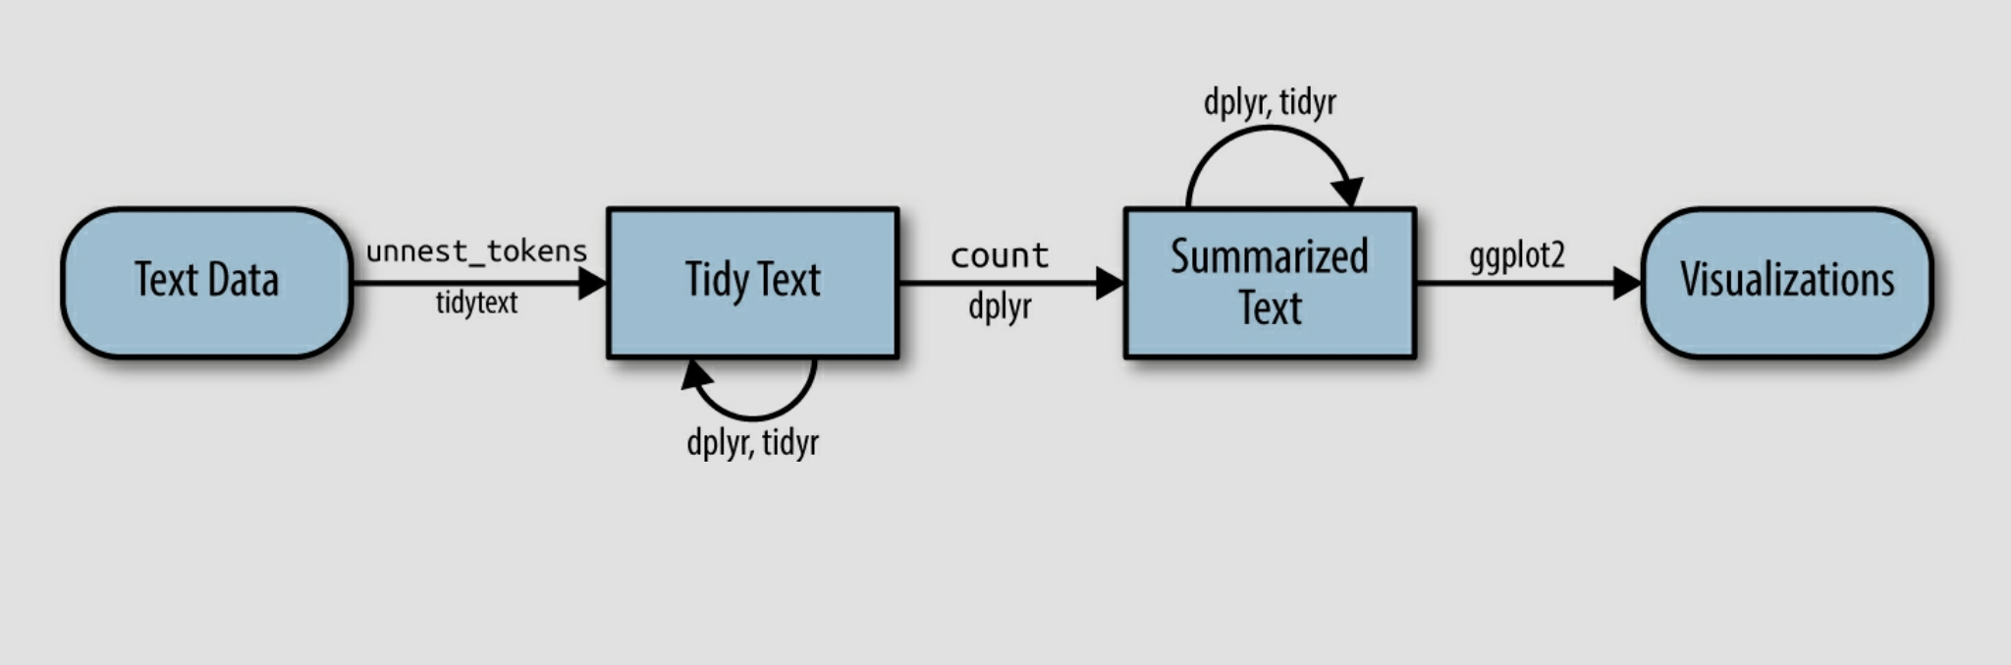
Tidytext: Text Mining in the Tidyverse

Slide 47
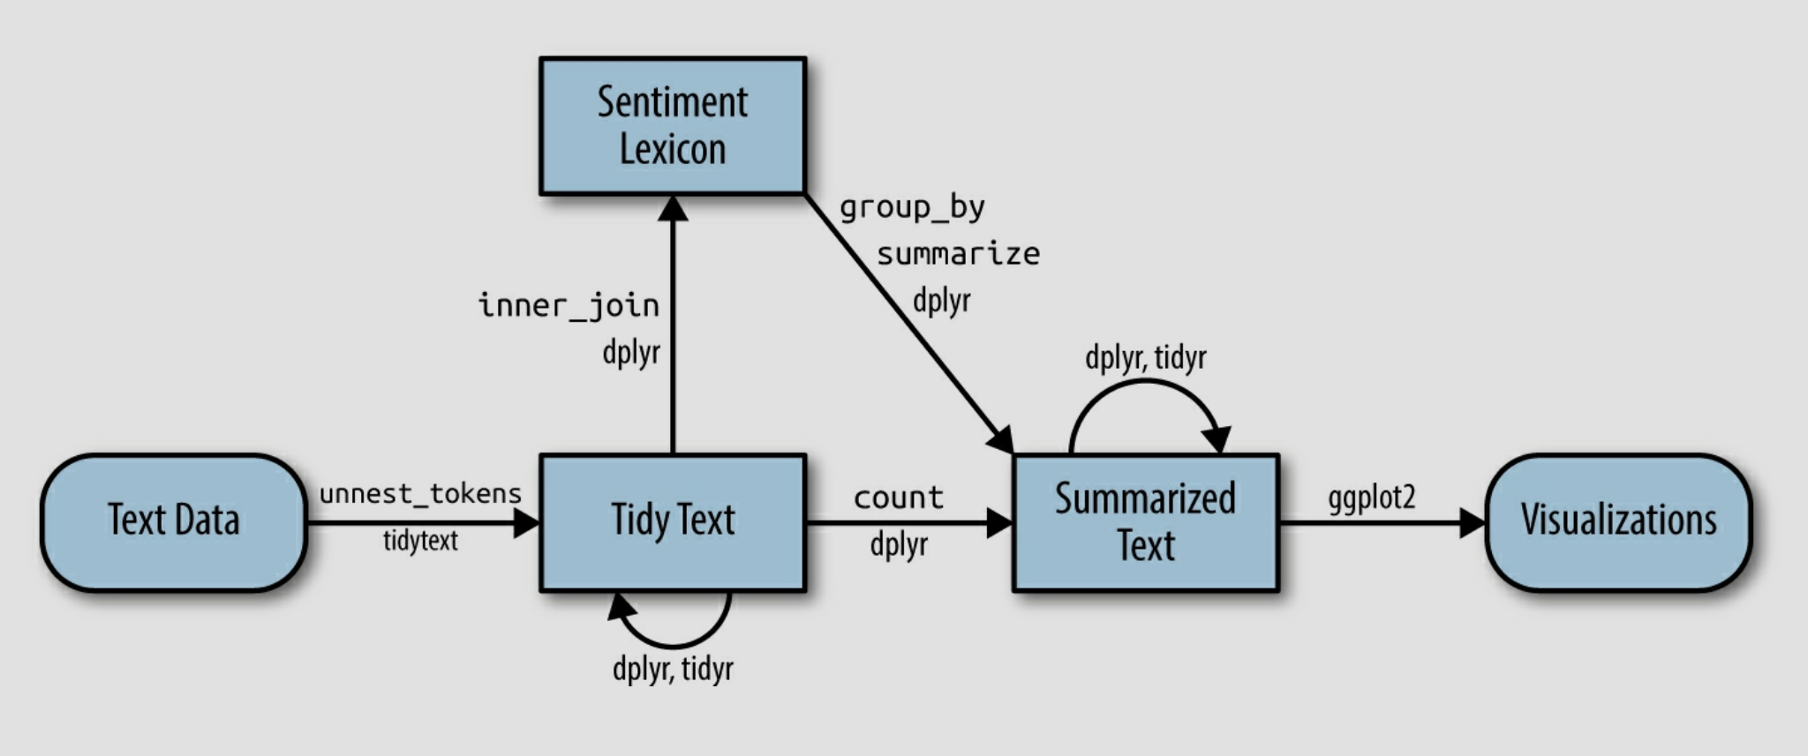
Tidytext: Text Mining in the Tidyverse

Slide 48
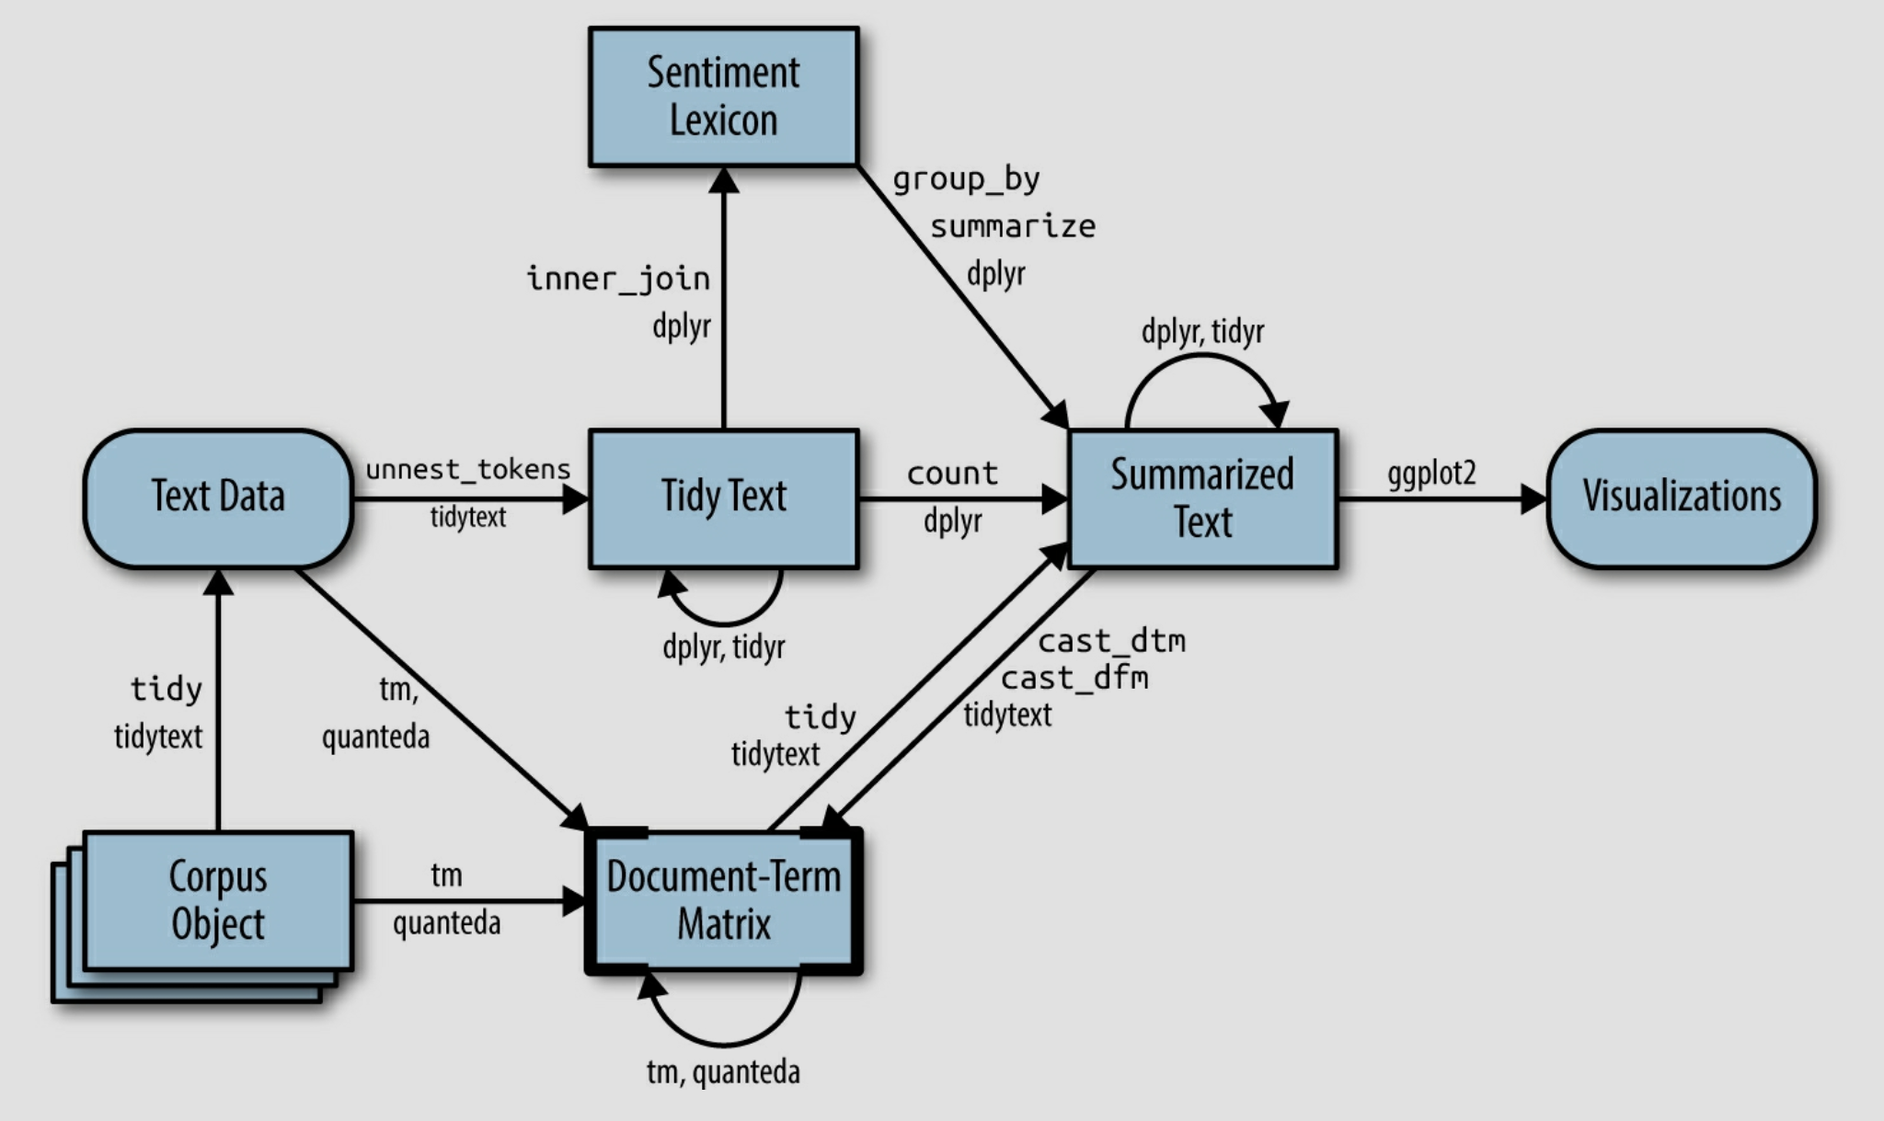
Tidytext: Text Mining in the Tidyverse

Slide 49
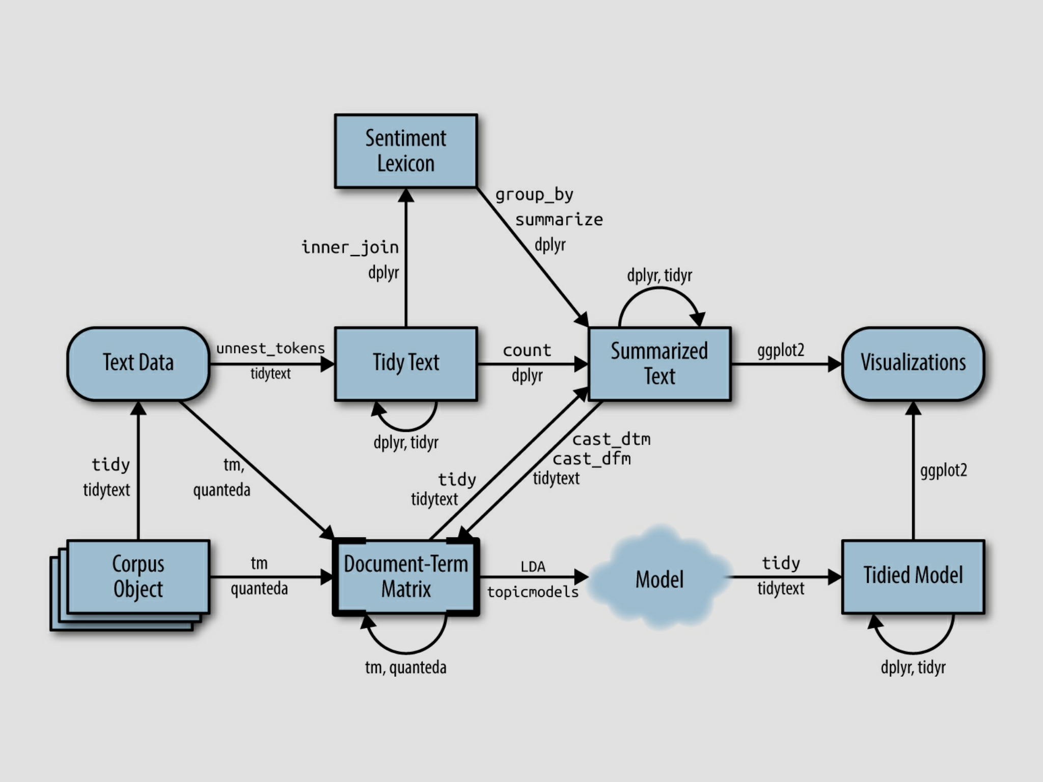
Tidytext: Text Mining in the Tidyverse

Slide 50
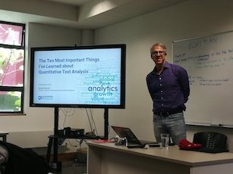
quanteda for Text Mining in R
quanteda package (3.1.0)
Quantitative Analysis of Textual Data (quanteda)
A family of packages:
quanteda.textmodels
quanteda.textstats
quanteda.textplots
quanteda.corpora (devtools)
quanteda.dictionaries(devtools)
quanteda.sentiment (under development)
quanteda.tidy (under development)
Created in 2018
Funded by the European Union
European Research Council
Very fast, handles large corpora well, handles dictionaries very well.
Supported by active researchers ( Quanteda Initiative, https://quanteda.org)
quanteda channel on StackOverflow
Our updated toolbox
tm, tidytext, quanteda
Kenneth Benoit
creator of quanteda

Slide 51
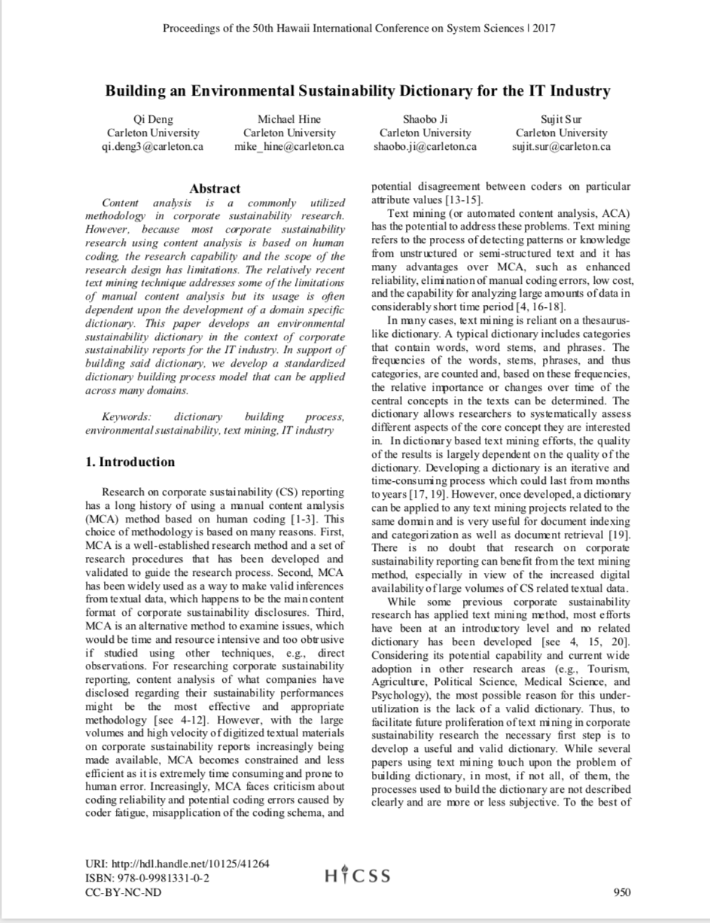
Categorization Models/Dictionaries/Lexicons
As opposed to inductive approaches, dictionaries take a deductive approach and are used when you want to detect the relative presence or absence of something in text.
This, something could be concepts that are:
Psychometric
Socio-Political
Linguistic
Other….
Dictionaries may be:
Domain-independent
Domain-specific
You may build your own or use/modify an existing one
May be used in stand-alone studies, or to create variables that can enhance other models
May address the polymorphy of language (different words reflect the same concept)

Slide 52
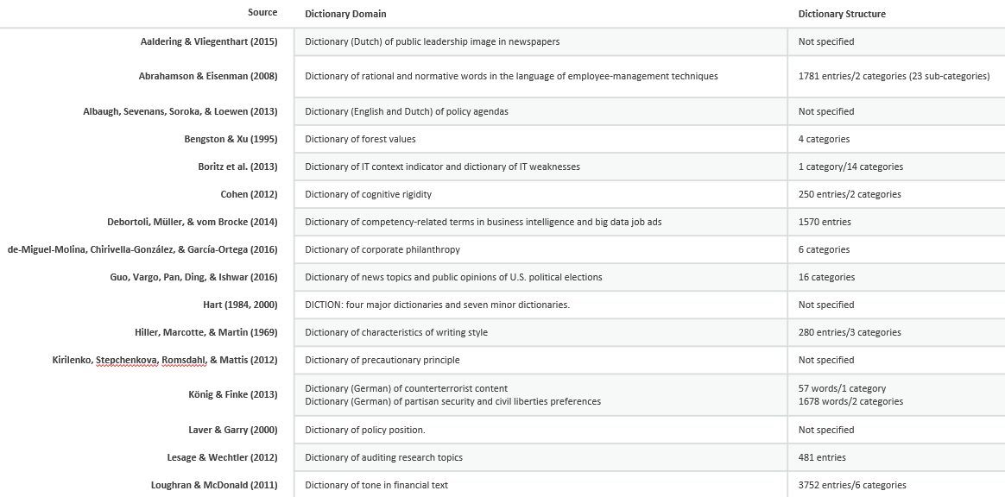
Some Existing Dictionaries
Notes:
From literature not necessarily from the real world
Point out:
Bengston & Xu: for a comprehensive example
Loughran & McDonald: dictionary of tone in financial text
The Forest Value Dictionary is composed of 612 words and phrases. It is a classification system that identifies four broad categories of forest values: economic/utilitarian, life support, aesthetic, and moral/spiritual values. The dictionary can be modified for use with other subjects.

Slide 53
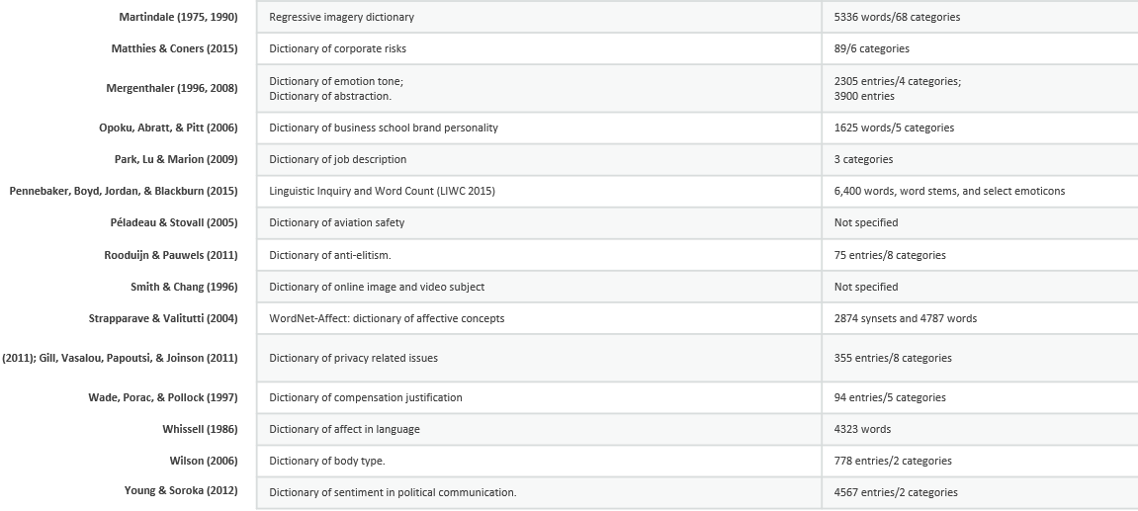
Some Existing Dictionaries
Notes:
Martindale
Pennebaker
- Note a lot of sentiment some are generic some are specific to a domain.

Slide 54
Dictionary Building
Difficult and time consuming to do properly
Requires both domain expertise and text analytic skills (if you want to leverage available technology)
Very little documented prescriptive advice exists
Bengston, D. N., & Xu, Z. (1995). Changing National Forest Values: a content analysis (Research Paper NC-323). Retrieved from United States Department of Agriculture, Forest Service, Northern Research Station Website: http://www.nrs.fs.fed.us/pubs/rp/rp_nc323.pdf
Deng, Q., M.J. Hine, S. Sur, and S. Ji (forthcoming) Inside the Black Box of Dictionary Building for Text Analytics: A Design Science Approach. Journal of International Technology and Information Management.
Deng, Qi, M.J. Hine, S. Ji, and S. Sur (2017). Building and Environmental Sustainability Dictionary for the IT Industry. Proceedings of the 50th Annual Hawaii International Conference on System Sciences. January, Kona, HI.

Slide 55
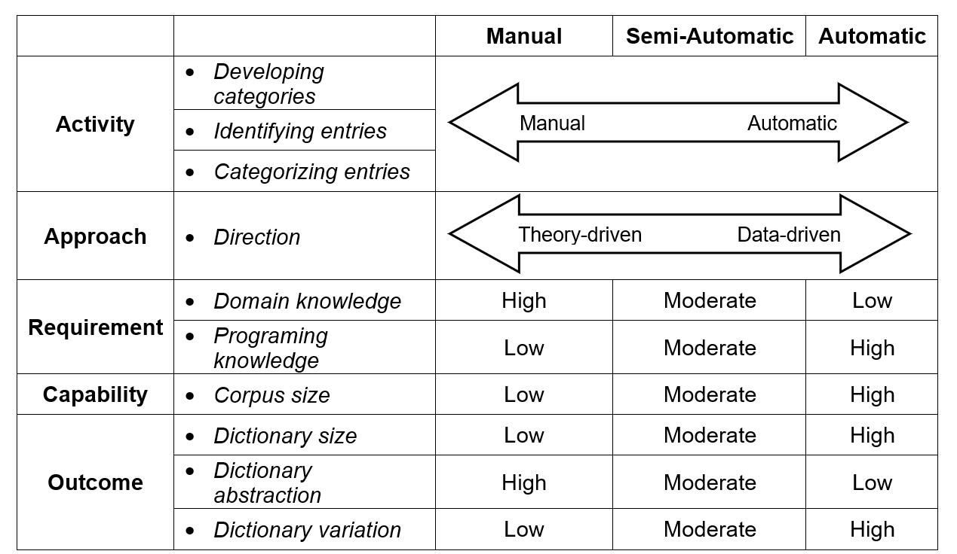
Dictionary Building Approaches
Deng, Qi, M.J. Hine, S. Ji, and S. Sur (2017). Building and Environmental Sustainability Dictionary for the IT Industry. Proceedings of the 50th Annual Hawaii International Conference on System Sciences. January, Kona, HI.
Notes:
Inductive approach
Rooted in traditional content analysis method, manual dictionary building is usually a theory-driven process, which is similar to the process of developing a coding schema (unless you are doing grounded theory).
Automatic dictionary building is rooted in the field of computational linguistics which focuses on modeling language (Jurafsky & Martin, 2000) and has mainly been applied in the field of Medical Science and Bioinformatics.
In general, it involves extracting key words and/or phrases automatically based on learning algorithms and subsequently evaluating the resulting dictionary through experiments or comparing it with existing dictionaries.
In the semi-automatic approach
researchers conduct the three activities and make their own judgments with the assistance of text analysis software.
For example, to develop a category structure, researchers could initially propose or adopt some categories based on theory and then modify them based on the result of automatic topic extraction from a corpus.
To identify the entries, one can first narrow down the scope of the corpus by setting up a frequency criterion with the help of text analysis software.
Since the core activities are conducted manually, this approach requires the highest domain knowledge and the lowest programing knowledge. In addition, it does not rely on a large corpus, and typically results in dictionaries with small sizes. Because it is a theory-driven process, the manual dictionary building approach usually results in dictionaries with high abstractions and low variations. The dictionaries developed using a manual approach usually have a theory-based and systematic category structure and are less probable to have unexpected categories or entries.
Automatic dictionary building is rooted in the field of computational linguistics which focuses on modeling language (Jurafsky & Martin, 2000) and has mainly been applied in the field of Medical Science and Bioinformatics. In general, it involves extracting key words and/or phrases automatically based on learning algorithms and subsequently evaluating the resulting dictionary through experiments or comparing it with existing dictionaries. Social sciences have just recently begun to adopt this method because of previous challenges associated with the large sample size requirement and its low methodological accessibility (Schwartz & Ungar, 2015). Compared to the manual approach, automatic dictionary building requires the lowest domain knowledge, but the highest programing knowledge. It can handle very large corpora and produce ‘big’ dictionaries. However, because it is a data-driven process, the resulting dictionaries may not correspond to theory and can result in unexpected categories and/or entries.
In the semi-automatic approach, researchers conduct the three activities and make their own judgments with the assistance of text analysis software. For example, to develop a category structure, researchers could initially propose or adopt some categories based on theory and then modify them based on the result of automatic topic extraction from a corpus. To identify the entries, one can first narrow down the scope of the corpus by setting up a frequency criterion with the help of text analysis software.
Each of the three dictionary building approaches has its advantages and disadvantages, and the choice of the appropriate one should be made based on the objectives of the research project under consideration. In this paper, we focus on semi-automatic dictionary building for three reasons. First, it is the most widely-adopted dictionary building approach (Brier & Hopp, 2011; Schwartz & Ungar, 2015). Second, the semi-automatic approach can potentially leverage existing theoretical bases and the contents of the corpus itself in executing the three dictionary building activities. Third, although the semi-automatic approach is not as computationally efficient as the automatic approach, it is self-justified by its accessibility: one does not need a programing background to adopt it. Therefore, our objective in this paper is to develop a process model for semi-automatic dictionary building.

Slide 56

Dictionary Development
Think about the how the existing sentiment dictionaries are structured
Instead of positive and negative categories, think about the categories of interest to you
Identify words that would be present if those categories were present in your data (what would you expect to find)
Structure the dictionary as a similar data frame and apply it the way you have applied the sentiment dictionaries.
Start small, with limited categories and words to get the idea, then build on the dictionary (it takes time).

Slide 57
Exploring the NIST Cybersecurity RFI Corpus with Traditional Bag of Words Approaches
Frequency Analysis
TF*IDF
Phrase Frequency (n-grams)
Dictionary Analysis

Slide 58
Tutorial on Advanced Text Analytics with NLP and GenAI
Agenda for the Tutorial: 1:00 – 4:00 p.m.
Welcome, Logistics, and Introductions (1:00-1:10)
Welcome and Logistics
Audience Introductions
Session I: Tutorial Overview/Dataset (1:10-1:15)
Text Mining in R and Python
NIST Cybersecurity RFI Corpus
Session II: Bag of Words Approaches (1:15-1:45)
Keyword and Phrase Frequency
Dictionaries and Sentiment Analysis
Session III: NLP-Syntactic Parsing and Unsupervised Machine Learning Approaches (1:45-2:15)
Named Entity Recognition
Topic Modeling
Coffee Break 2:15 – 2:45
Session IV: Supervised Machine Learning: Classification and Regression (2:45-3:15)
Predictive Models – Classification
Predictive Models – Regression
Session V: Generative AI and RAG (3:15-3:45)
Prompt Engineering
Notebook LM/AI Studio
Wrap-up, Discussion, Next Steps (3:45 – 4:00)
HICSS Community on Text Analytics

Slide 59
Session III: NLP – Syntactic Parsing .. and Unsupervised Machine Learning .
HICSS-58 Tutorial
Tuesday, 7 January 2025 Room: Kona 4 1:00 – 4:00 p.m. HST

Slide 60
Natural Language Processing in R and Python
Reminder: Two Broad Approaches to Text Mining
Statistical “Bag of Words”
NLP Syntactic Parsing
Thus far the BoW approach, ignoring word order, has been able to get us pretty far down the analytical road.
It is a tremendously powerful tool; and relatively inexpensive, in terms of time and computing resources.
Requires programming and computing skills, but not completely overwhelming.
As we move to make use of NLP techniques that explicitly take advantage of the specific role of words within a sentence, some of those factors will change.

Slide 61
Natural Language Processing in R and Python
This highly rewarding NLP approach to text mining will generally be more computationally intensive, more time intensive, and will require more advanced programming and computational skills.
NLP involves part of speech (POS) tagging, which is a method for syntactically parsing text and annotating the part of speech of each individual word within a sentence.
POS allows us to identify a range of entities within the text, including noun phrases.
This approach leads us to the powerful Named Entity Recognition (NER) technique, wherein we can automate the process of extracting names of people, organizations, locations, and other types of structured information from text.

Slide 62
Natural Language Processing in R
R Packages for Conducting NLP:
NLP
openNLP
coreNLP
cleanNLP
spacyr
Objectives:
Understanding and installing openNLP
Named Entity Recognition (NER) and NER Libraries
Using APIs to get locations
Create a bar chart of recognized organizations
Use a heat map to understand entity interactions
Apply polarity scoring to entities

Slide 63
Natural Language Processing with the spacyr Package
spacyr provides a convenient R wrapper around the Python spaCy package. It offers easy access to the following functionality of spaCy:
parsing texts into tokens or sentences;
lemmatizing tokens;
parsing dependencies (to identify the grammatical structure of the sentence); and
identifying, extracting, or consolidating token sequences that form named entities or noun phrases.

Slide 64
Natural Language Processing with the spacyr Package
spacyr engages the powerful spaCy Python NLP libraries; and is designed to work closely with quanteda or alone
spaCy is a free, open-source library for advanced Natural Language Processing (NLP) in Python.
spaCy is designed specifically for production use and helps you build applications that process and “understand” large volumes of text. It can be used to build information extraction or natural language understanding systems, or to pre-process text for deep learning: https://spacy.io/usage/spacy-101
# You may also parse and POS tag documents in multiple languages using over 70 language models (some of these include: English (en), German (de), Spanish (es), Portugese (pt), French (fr), Italian (it), Dutch(nl), and many others:
See: https://spacy.io/usage/models#languages for a complete list)

Slide 65
openNLP
Toolkit for supporting natural language processing tasks.
Apache Software Foundation offers OpenNLP for free
Can perform:
Part of speech (POS) tagging
Named Entity Recognition (NER)
Using openNLP Apache Library requires Java
R package openNLP enables you to wrap the Java in R
Approach:
breaking down documents into sentences, phrases, parts of speech, and named entities according to syntactic parsing methods
breaking the sentence down into “tags” or “annotations” in R, using an “annotation model”

Slide 66
Figure 8.1 An example sentence parsed with various annotations
Last night
Apply sentence annotation first.

Slide 67
Maximum Entropy (maxent)
The annotation models identify sentences, tokens (words), parts of speech, and named entities through a method called maxent
Maxent is an information-based (not probability-based) machine learning technique for classification
Information-based ML techniques look for the average pattern occurrence for a particular feature
The dependent (target) class is the annotation tag (e.g. noun)
The input (features) are patterns about the text that have been observed
Entropy is a measure of uncertainty in a distribution. It measures an event probability and the event’s “surprise” given the prior observation’s average occurrence
Annotation models maximize entropy (uncertainty) by balancing complete uncertainty and applying constraints based on observed information

Slide 68
Five Functions of the OpenNLP Using Maximum Entropy (Maxent)
Function Name | Description
Maxent_Chunk_Annotator | Text chunking identifies the noun or verb groups within a sentence.
Maxent_Entity_Annotator | Can detect named entities and numbers.
Maxent_POS_Tag_Annotator | Marks word tokens with a class, such as noun or adjective.
Maxent_Sent_Token_Annotator | Detects punctuation marks to determine the end of a sentence.
Maxent_Word_Token_Annotator | Segments characters into tokens (words, numbers, punctuation marks).

Slide 69
Named Entity Recognition Models in OpenNLP
Kind | Description | Example Entities
Date | Extracts dates from text | Thursday, April 29, 2011; tomorrow
Location | Extracts possible locations | United States; Syria, The White House
Money | Identifies currency | $96.5 million
Organization | Extracts organizations by name or acronym | National Security Council; NSC
Percentage | Identifies percent values | 75 percent; 83%
Person | Identifies proper nouns for people | Tony Blair, Bill

Slide 70
Penn Treebank Part of Speech (POS) Tag Codes
POS Tag | Description
CC | Coordinating conjunction
CD | Cardinal number
DT | Determiner
EX | Existential there
FW | Foreign word
IN | Preposition or subordinating conjunction
JJ | Adjective
JJR | Adjective, comparative
JJS | Adjective, superlative
LS | List item marker
MD | Modal
NN | Noun, singular or mass
NNS | Noun, plural
NNP | Proper noun, singular
NNPS | Proper noun, plural
PDT | Predeterminer
POS | Possessive ending
PRP | Personal pronoun
POS Tag | Description
PRP$ | Possessive pronoun
RB | Adverb
RBR | Adverb, comparative
RBS | Adverb, superlative
RP | Particle
SYM | Symbol
TO | To
UH | Interjection
VB | Verb, base form
VBD | Verb, past tense
VBG | Verb, gerund or present participle
VBN | Verb, past participle
VBP | Verb, non third person singular present
VBZ | Verb, third person, singular present
WDT | Whdeterminer
WP | Whpronoun
WP$ | Possessive whpronoun
WRB | Whadverb

Slide 71
What is Machine Learning?
An extension of artificial intelligence (AI)
Tool set, methods, and approaches that allow a computer to write code from data (uses algorithms to automate the process of data analysis)
Algorithmic approach to text to:
Recommendations/Predictions (Pandora/Amazon)
Classification (Known data to define new data =spam
Clustering (New groups of similar data=Google News)
Two main approaches to machine learning (ML)
Unsupervised Machine Learning
Supervised Machine Learning

Slide 72
Unsupervised and Supervised ML
Unsupervised Machine Learning
Does not have a specified dependent (or outcome) variable
Algorithm looks for complex patterns within the data
Infers patterns, such as clusters (topics, factors)
Supervised Machine Learning
Requires a dependent (or outcome) variable (y)
Algorithm results in a prediction or classification for y (which is the algorithm’s ”best guess” at the y value (it is not magic – smile)
For prediction the y variable must be continuous); for classification the y variable must be categorical

Slide 73
Unsupervised ML Techniques
Clustering Algorithms
Automatically extracting broad topics from a large group of documents (without reading the documents).
Clustering Approaches
K-means Clustering (uses mean)
Spherical K-means Clustering (uses cosine, handles sparse matrices)
K-mediods Clustering (uses median)
String Distance (uses distance between a string and a vector of strings)
Topic Modeling (using LDA, Latent Dirichlet allocation; and LDAvis)

Slide 74
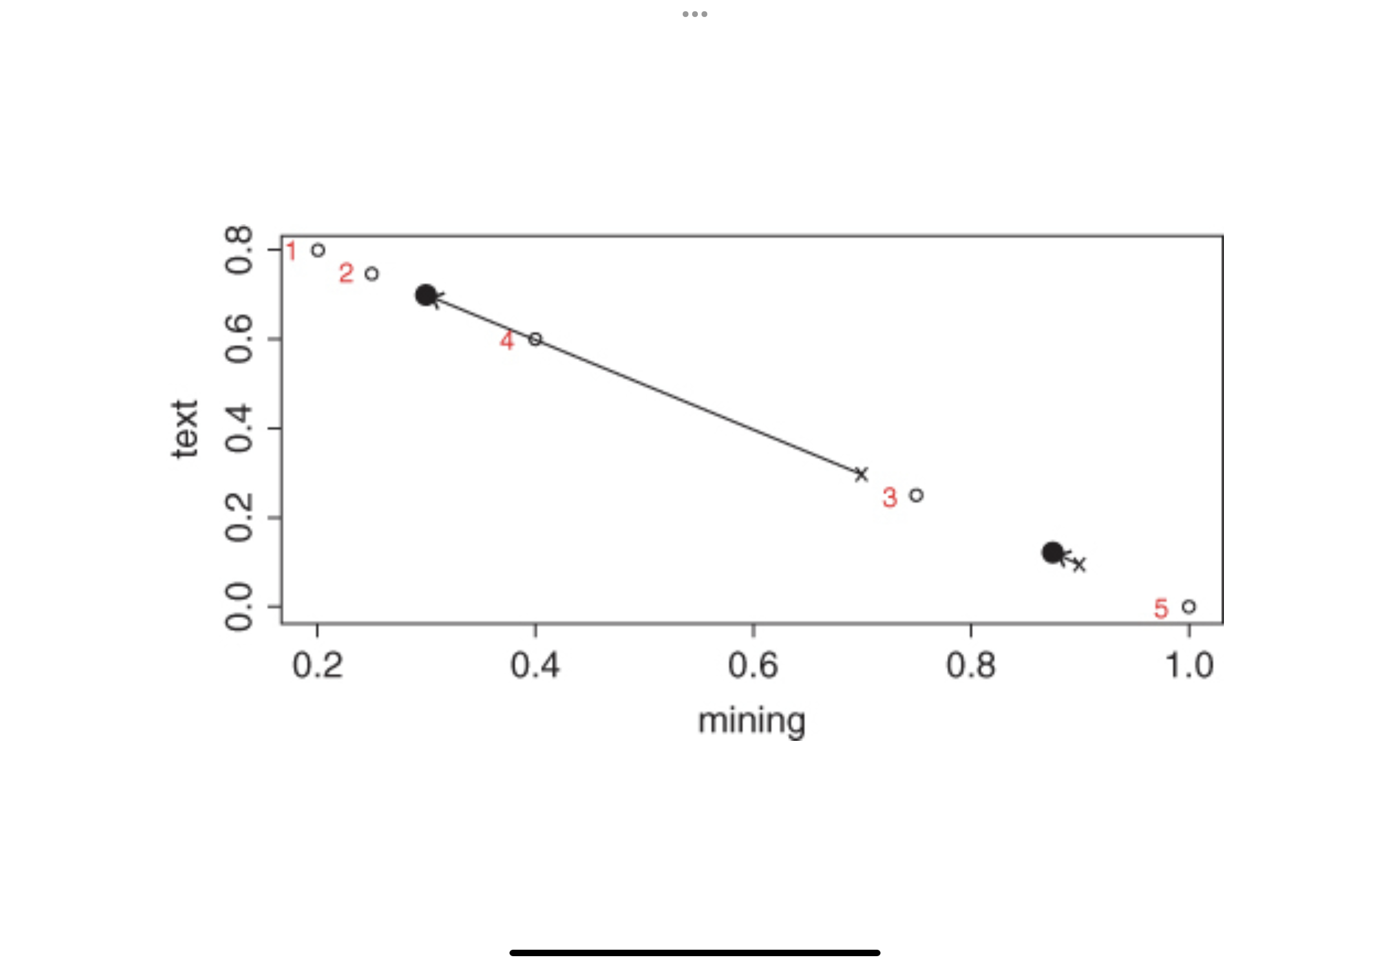
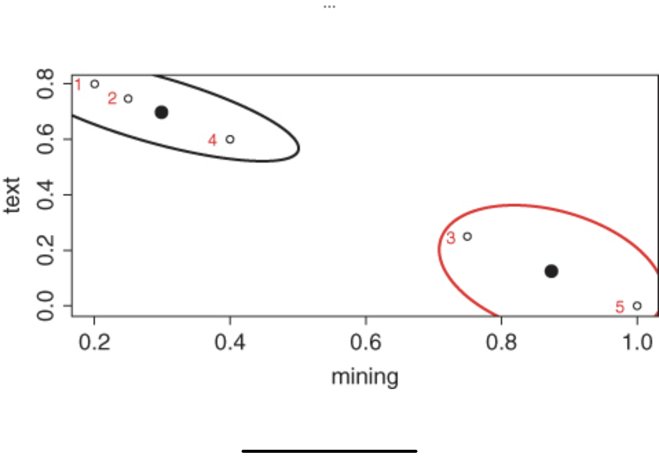
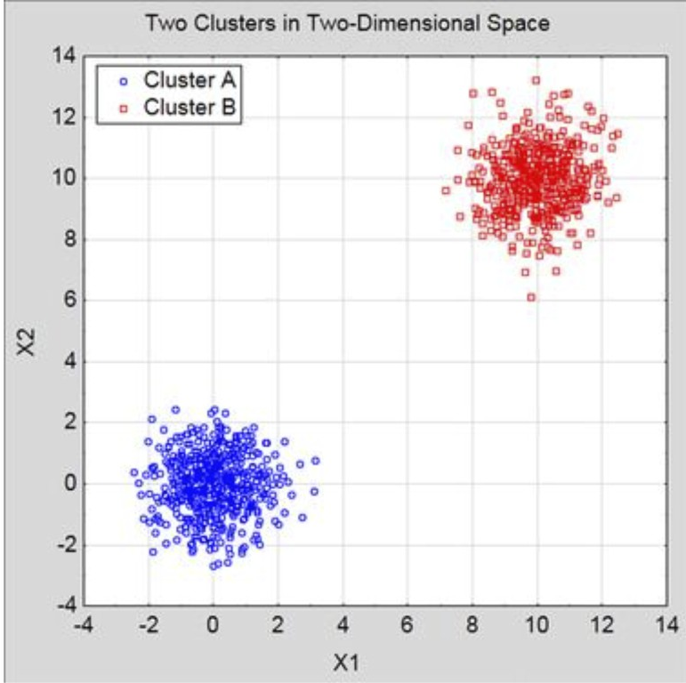
Unsupervised ML Techniques
K-Means Clustering: Partitioning documents into a number of predefined “k” clusters which should be similar in the terms used within the documents
Choose the number of clusters (“k”) – must be chosen before partitioning
For every cluster k, a random point is selected as the centroid by the algorithm
Each document is assigned to a “cluster” in the closest centroid
Sum of distance from all documents to the centroid is calculated; those centroids are then moved to the average distance sum of all assigned documents from the original randomly chosen centroid. (When the centroids move, the clusters will gain and lose documents.
K-means algorithm will stop when the sum of cluster distances cannot be reduced further.

Slide 75
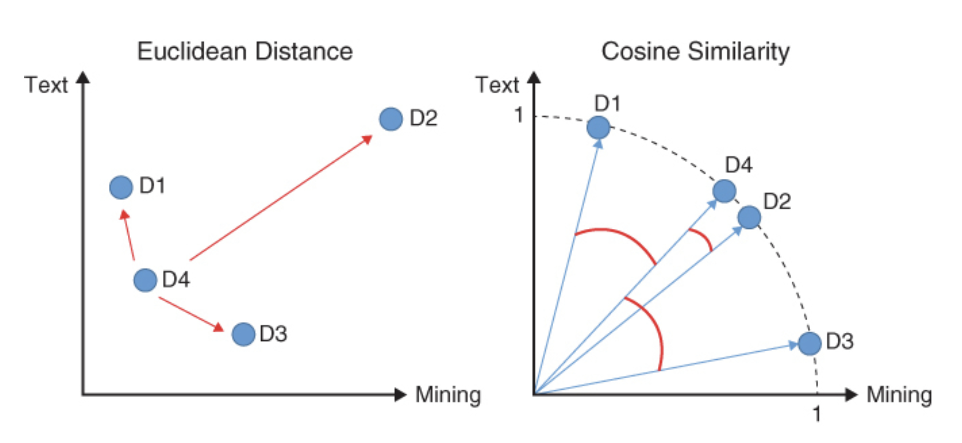
Unsupervised ML Techniques
Spherical K-Means : Partitions documents into a number of predefined “k” clusters similar to regular k-means, but “similarity” distance is measured differently (uses cosine similarity). Spherical k-means also handles sparse matrices well (e.g. a DTM with lots of “0” values)

Slide 76
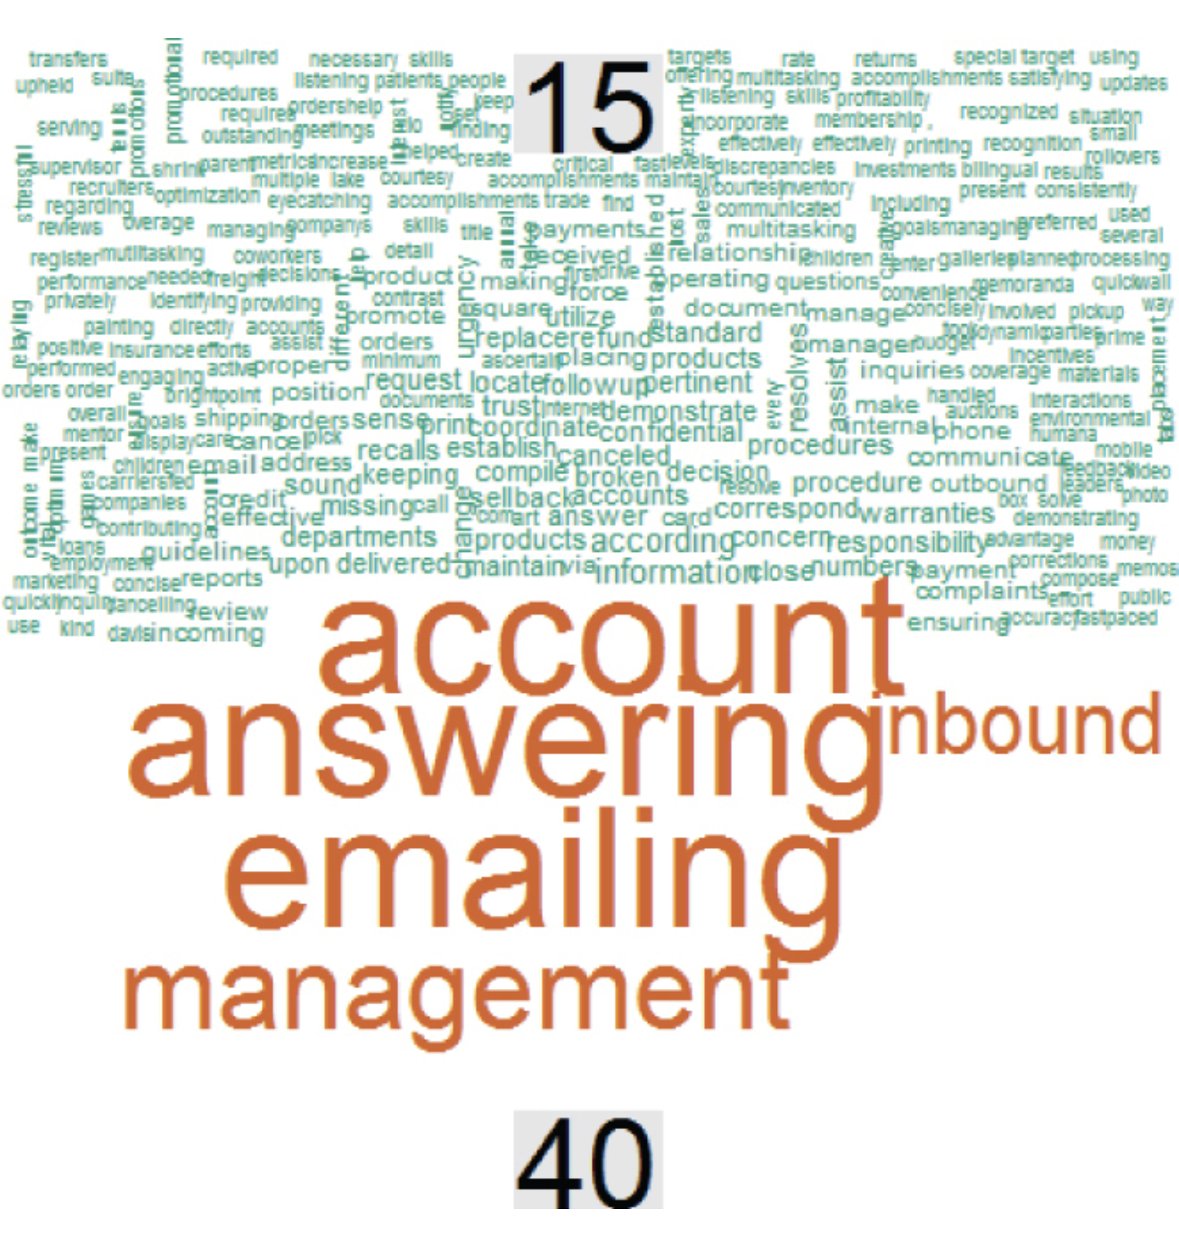
Unsupervised ML Techniques
K-Medoid Clustering: Uses the median value instead mean for similarity measurement. Creates a PAM object, partition around median for its “mediods” rather than “centroids”. However, instead of a random point in space used for the k-means approach, the k-mediods approach will always pick an actual document.
Benefits of using K-Mediod Clustering
Since the approach utilizes actual prototypical centers rather than a calculated point in space, you will be able to get an explicit example for each cluster.
K-mediod clusters are less affected by outliers. K-means clusters can be affected if there is an outlier document, meaning a document that uses terms completely unlike the rest of the collection in either diversity or frequency.

Slide 77
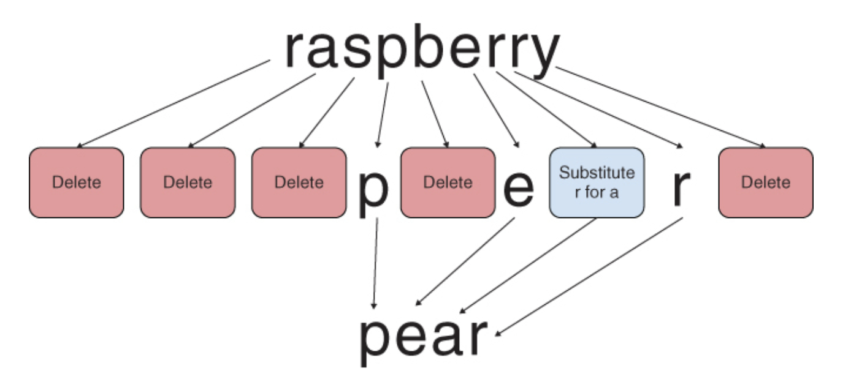
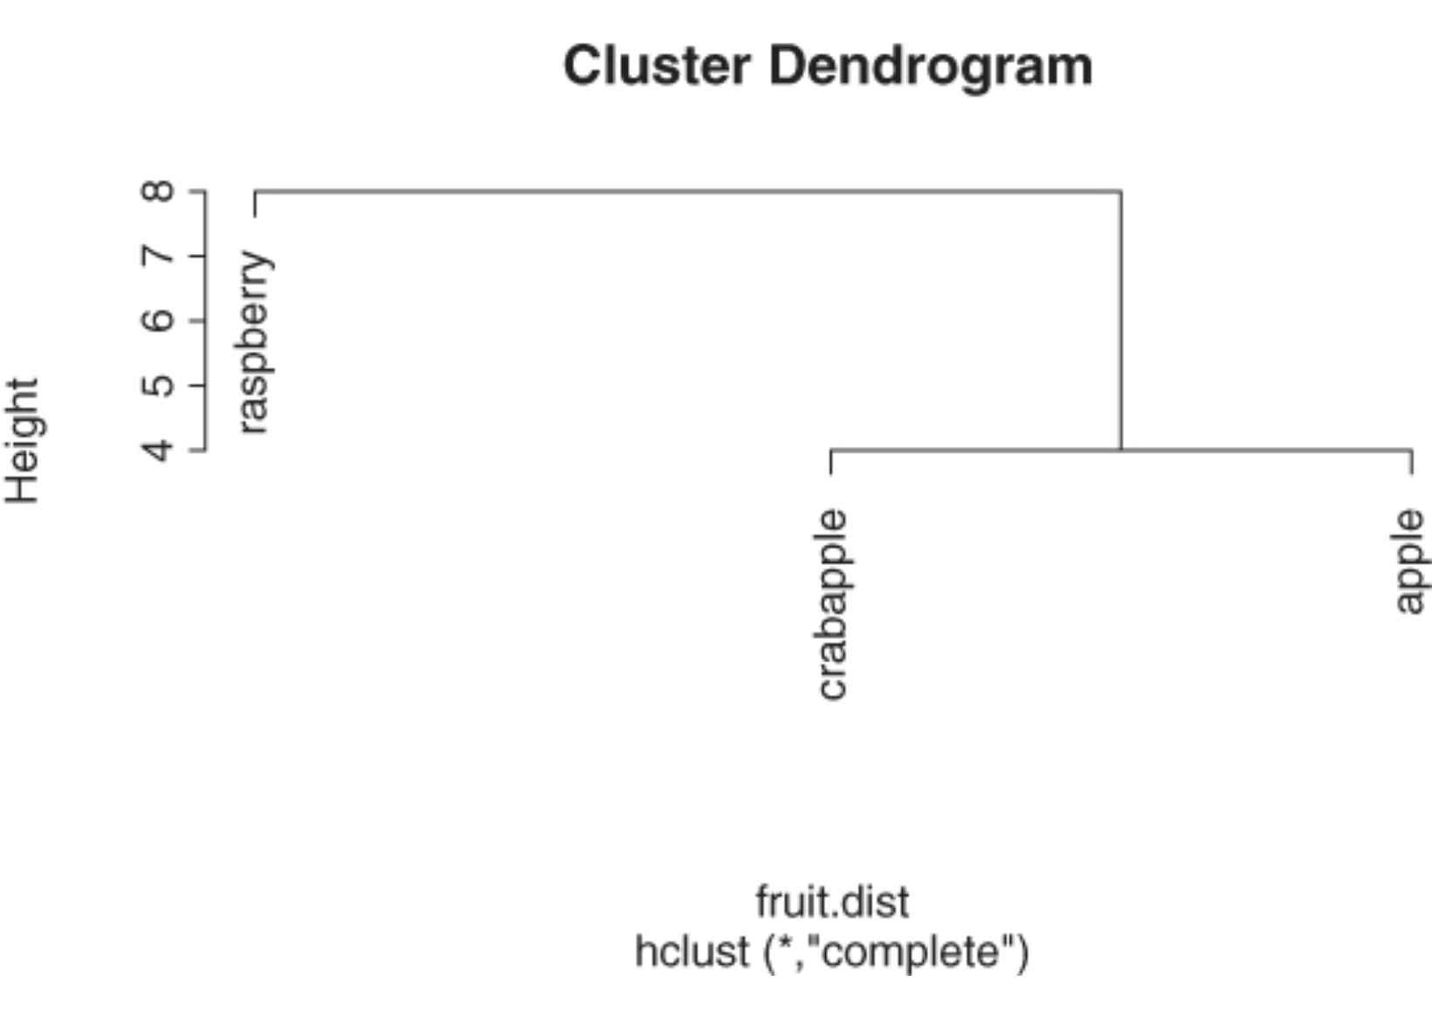
Unsupervised ML Techniques
String Distance: Different approach to measuring distance and similarity than Euclidean distance or cosine similarity. String distance is the measurement of one string to another at the character level. That is to say the number of letters that need to be changed in some manner to make that string into another (e.g. “cat” to “bat” has a string distance of 1).
The string distance package (stringdist) has three important functions within the context of text mining (it can also work on integers).
The first amatch (and related ain) compute a fuzzy match between a character string and a table of other strings. The result of the function is the position in the table that is a fuzzy match.
The stringdist function calculates the distance between a string and a vector of various strings.
Still a third useful function in this package is stringdistmatrix used to calculate a distance matrix that can be used in clustering.

Slide 78
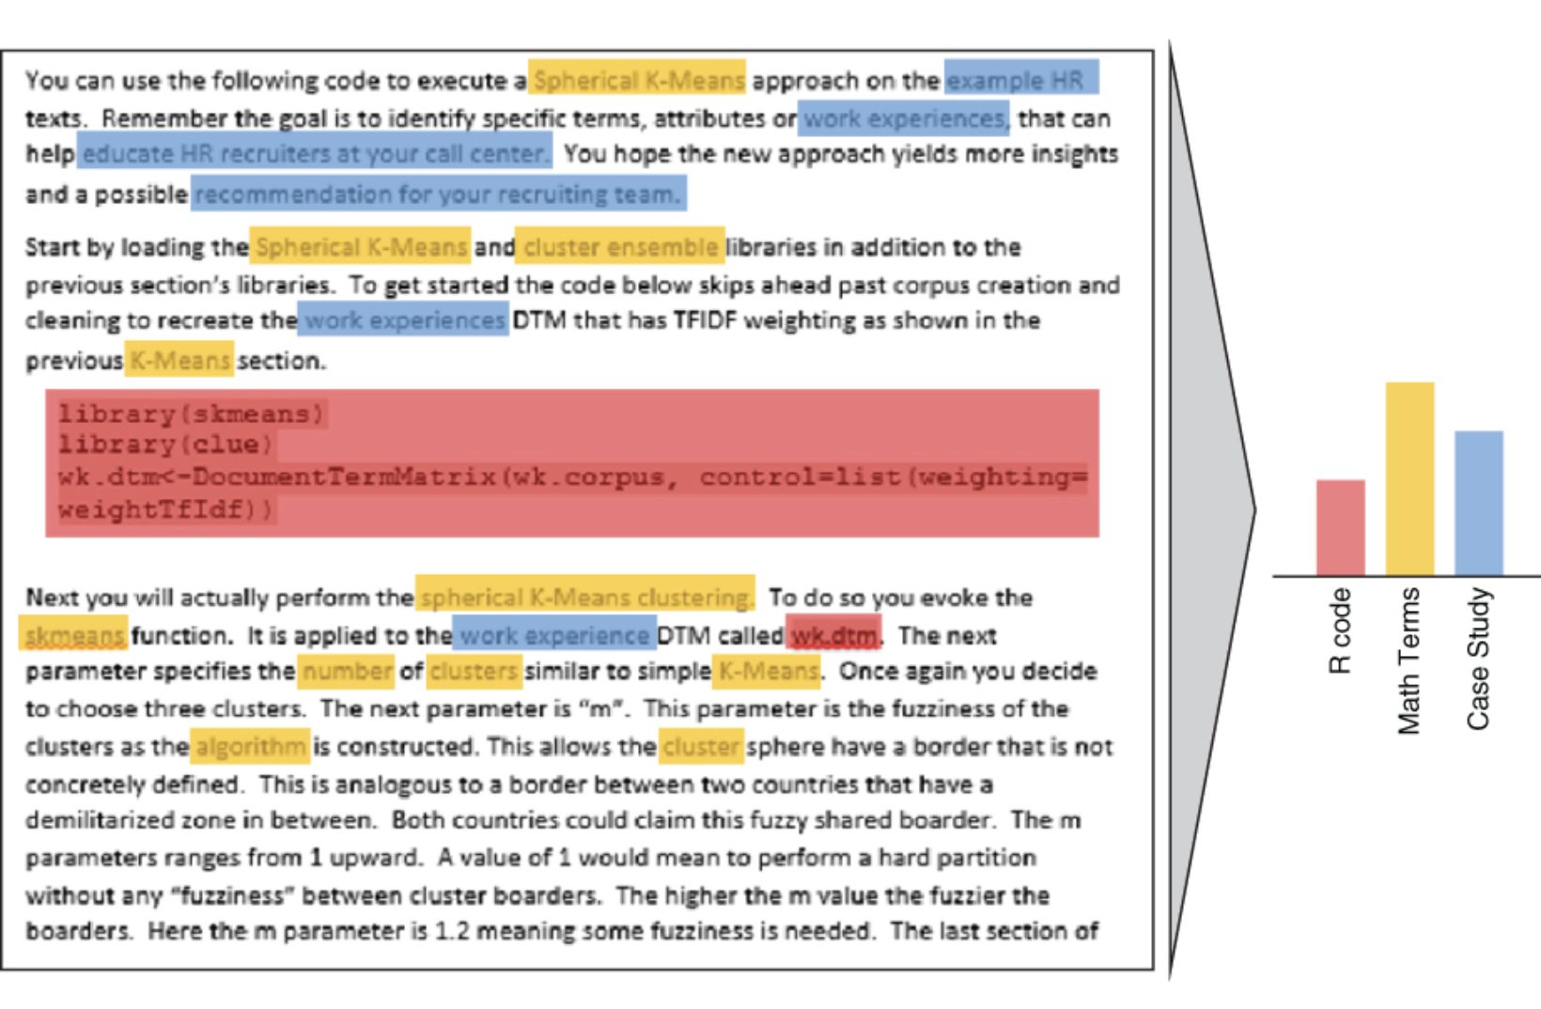
Unsupervised ML Techniques
Latent Dirichlet Allocation: One of the most common algorithms for topic modeling is LDA. It is a particularly popular method for fitting a topic model.
LDA Topic Modeling is guided by these two principles:
Every document is a mixture of topics
We imagine that each document may contain words from several topics in particular proportions. For example, in a two-topic model we could say “Document 1 is 90% topic A and 10% topic B, while Document 2 is 30% topic A and 70% topic B.”
Every topic is a mixture of words
For example, we could imagine a two-topic model of American news, with one topic for “politics” and one for “entertainment.” The most common words in the politics topic might be “President,” “Congress,” and “government,” while the entertainment topic may be made up of words such as “movies,” “television,” and “actor.” Importantly, words can be shared between topics; a word like “budget” might appear in both equally.
LDA is a mathematical method for estimating both of these principles at the same time: finding the mixture of words that is associated with each topic, while also determining the mixture of topics that describes each document

Slide 79
Exploring the NIST Cybersecurity RFI Corpus with NLP and Unsupervised ML Approaches
Named Entity Recognition (NER)
Topic Modeling
K-Means Clustering

Slide 80
Tutorial on Advanced Text Analytics:
The NIST AI Cybersecurity RFI Corpus
If you have not yet checked in for the session, please scan the QR Code to enter name, email, and GitHub ID
Coffee Break
(2:15-2:45 p.m.)
Minitrack on AI Safety, Cybersecurity, and Inclusion Through Advanced Text Analytics Minitrack on Culture, Identity, and Inclusion
#HICSS_bigdatatext

Slide 81
Tutorial on Advanced Text Analytics with NLP and GenAI
Agenda for the Tutorial: 1:00 – 4:00 p.m.
Welcome, Logistics, and Introductions (1:00-1:10)
Welcome and Logistics
Audience Introductions
Session I: Tutorial Overview/Dataset (1:10-1:15)
Text Mining in R and Python
NIST AI Cybersecurity Data
Session II: Bag of Words Approaches (1:15-1:45)
Keyword and Phrase Frequency
Dictionaries and Sentiment Analysis
Session III: NLP-Syntactic Parsing and Unsupervised Machine Learning Approaches (1:45-2:15)
Named Entity Recognition
Topic Modeling
Coffee Break 2:15 – 2:45
Session IV: Supervised Machine Learning: Classification and Regression (2:45-3:15)
Predictive Models – Classification
Predictive Models – Regression
Session V: Generative AI and RAG (3:15-3:45)
Prompt Engineering
Notebook LM/AI Studio
Wrap-up, Discussion, Next Steps (3:45 – 4:00)
HICSS Community on Text Analytics

Slide 82
Session IV: Supervised Machine Learning: Classification and Regression Modeling .
HICSS-58 Tutorial
Tuesday, 7 January 2025 Room: Kona 4 1:00 – 4:00 p.m. HST

Slide 83
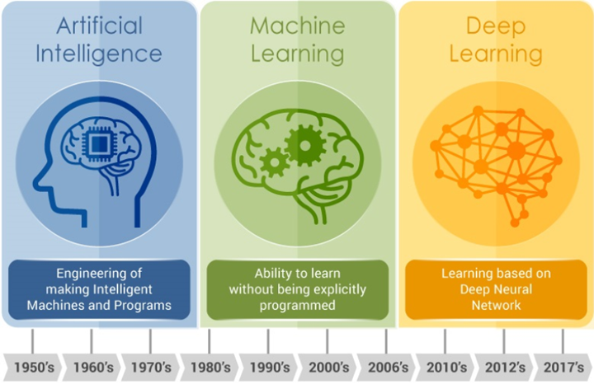
What is AI?
Source: https://medium.com/analytics-vidhya/ai-ml-dl-whats-what-ecb354967e63

Slide 84
What is Machine Learning?
An extension of Artificial Intelligence (AI)
Tool set, methods, and approaches that allow a computer to write code from data (uses algorithms to automate the process of data analysis) and increasingly in decision making.
Algorithmic approach to text to:
Recommendations/Predictions (Pandora/Amazon)
Classification (Known data to define new data =spam
Clustering (New groups of similar data=Google News)
Two main approaches to machine learning (ML)
Unsupervised Machine Learning
Supervised Machine Learning

Slide 85
Unsupervised and Supervised ML
Unsupervised Machine Learning
Does not have a specified dependent (or outcome) variable
Algorithm looks for complex patterns within the data
Infers patterns, such as clusters (topics, factors)
Supervised Machine Learning
Requires a dependent (or outcome) variable (y)
ML algorithm results in a regression or a classification prediction for y (which is the algorithm’s ”best guess” at the y value (it is not magic – smile)
For regression models the y variable must be numeric/continuous);
for classification models the y variable must be categorical

Slide 86
Purposes of Supervised ML Models
In both classification models and regression models we can use the tools of supervised machine learning to connect our input, which may exist entirely or partly as text data, with our outcome of interest. Most supervised ML models are built with one of three purposes in mind:
Predictive Model
Generate the most accurate predictions possible
Inferential Model
Test a hypothesis or draw conclusions about a population
Descriptive Model
Describe the properties of the observed data

Slide 87
What is Predictive Analytics?
Predictive Analytics
Building regression or classification models based on past data that can help you predict future data
Regression Models
Using previous data to predict a numeric or continuous value
Basic Steps
Identify and use relevant past data
Model your outcome (train)
Validate/Test your model (test)
Apply the model to new data
Classification Models
Using previous data to predict if new data belongs to a specific “class” or group
Basic Steps
Identify the desired classes
Use machine learning algorithm (such as naïve bayes) to develop a “classifier” with a certain percentage accuracy
Use the classifier to place new data into a specific class

Slide 88
Supervised Machine Learning
Outcome variables for Supervised Machine Learning
Classification (identifying categorical (class) outcomes)
For example: Winners and losers of a basketball game (W/L)
Continuous Prediction (predicting continuous outcomes)
For example: The final team score of a basketball game (0/…)
Training step, where labeled data is fed into the algorithm
The algorithm is applied to new data and the output is a predicted value

Slide 89
Supervised Machine Learning

Slide 90



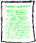
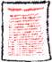
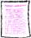
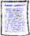


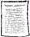
Automated Document Classification
Document Classification assigns a document to one or more classes or categories
1) Training Phase
Classification Rules
2) Classification of documents
? ? ? ? ?
Classification Rules

Slide 91
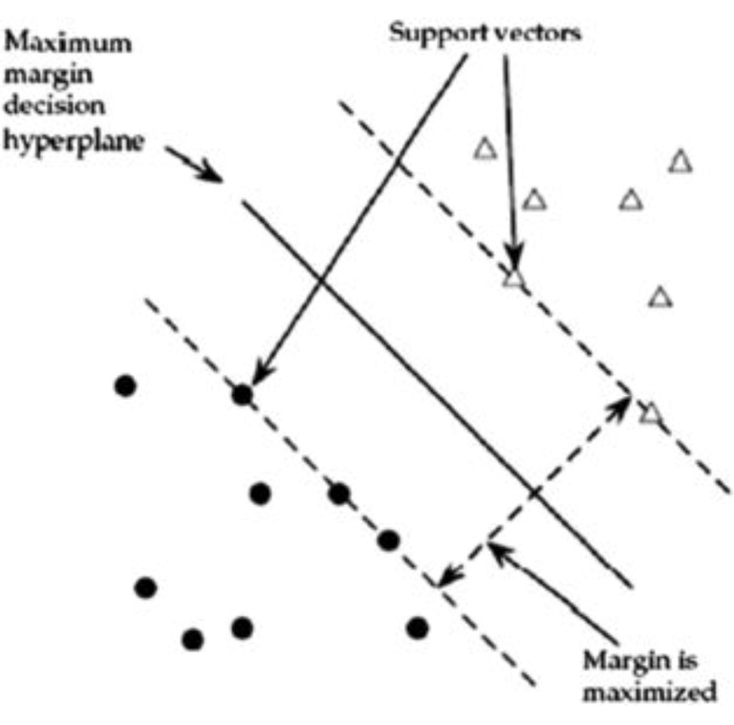
Methods of Automated Document Classification
Naïve Bayes Classifiers
Probabilistic classifiers that are based on Bayes’ theorem, which states that the probability of an event’s occurrence is equal to the intrinsic probability times the probability that it will happen again (naïve = simplistic assumption that the objects are completely independent of one another
K-Nearest Neighbor Method
A method to cluster documents based on their distance to the K nearest “neighbor” documents

Slide 92
Regression Models
To do predictive analytics on text in R, we can use the tidymodels, textrecipes, and the workflows packages.
Here is what each of these packages is used for:
tidymodels
Splitting the data into training and testing sets
Using the recipes package functions for data preprocessing and feature engineering
textrecipes
Extending the recipes package by providing steps that create features for modeling from text
workflows
Provides infrastructure for bundling model components
A model workflow is a convenient way to combine different modeling components (e.g a preprocessor, plus a model specification). Thi9s can help you keep track of your modeling plan

Slide 93
Evaluating Your Regression Model
You can evaluate your regression model in a number of ways.
You can predict one time on the testing set to measure performance.
However, that testing set is so valuable that you don’t want to use it more than once. The purpose is to “estimate” how your model will perform on new data. We are pretending that this set aside data is not from the same dataset we used to train the model, so we can use it to test the predictive power of the model. We have to be careful not to “overfit” the model because this is the same data on which the model was trained.
If you have a large enough dataset, you can split your data into three (not two) sets;
testing, training, and validation.
To do this, we can use the resampling package within tidymodels.
It will allow us to conduct data splitting and and resampling.
When we resample, we create new simulated data sets from the training set for the purpose of, for example, measuring model performance.
For example, we can create a 10-fold cross validation set.

Slide 94
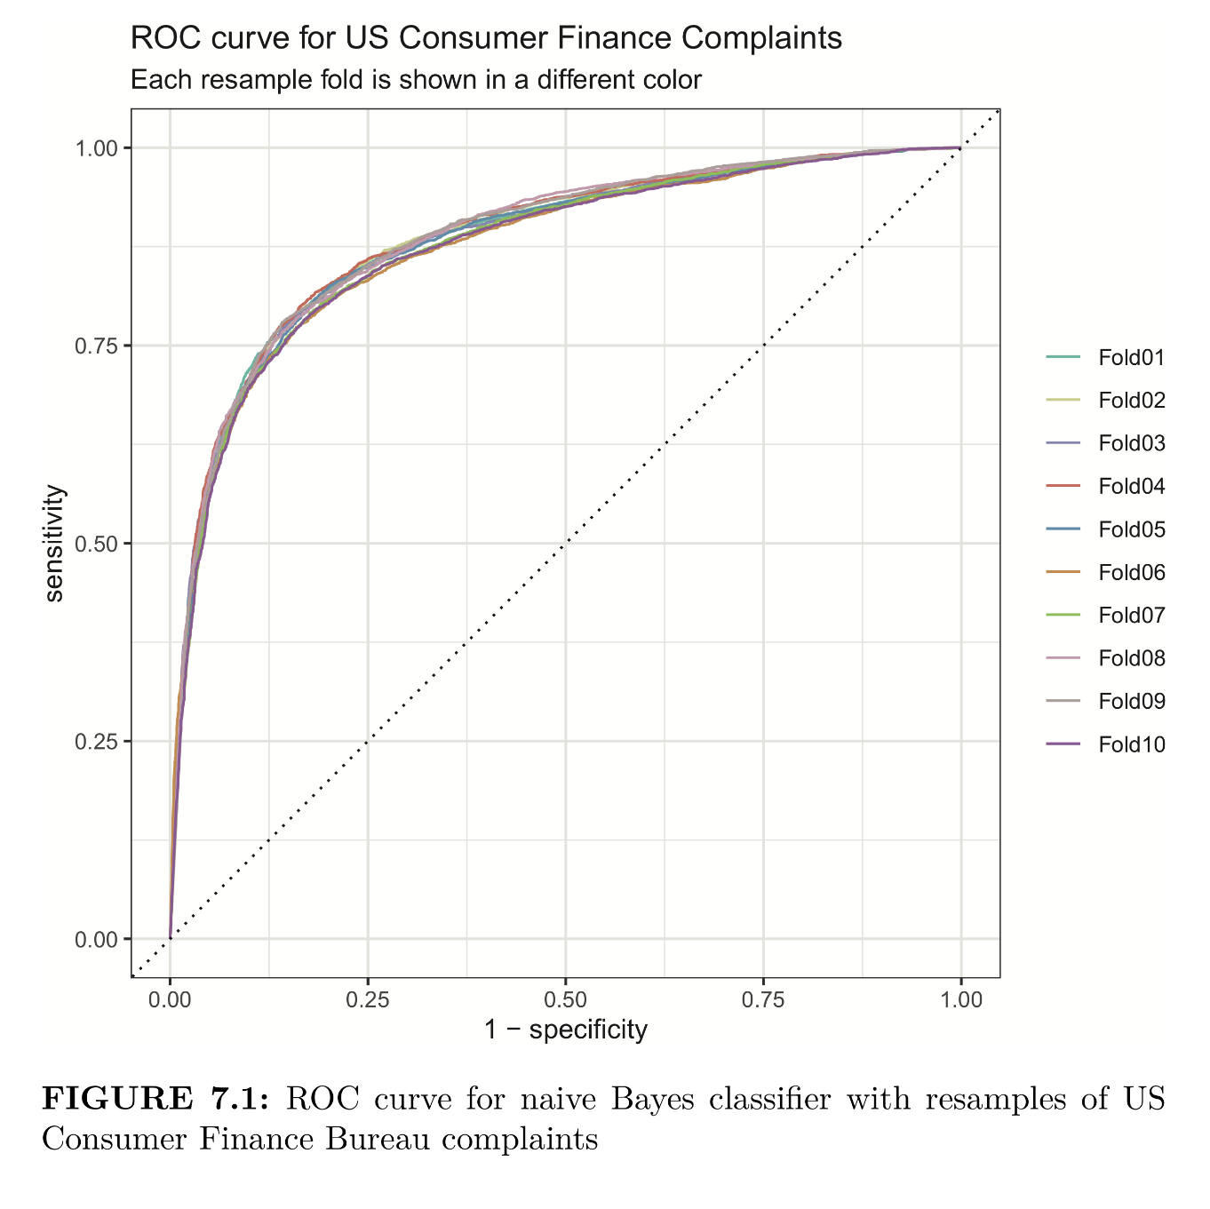
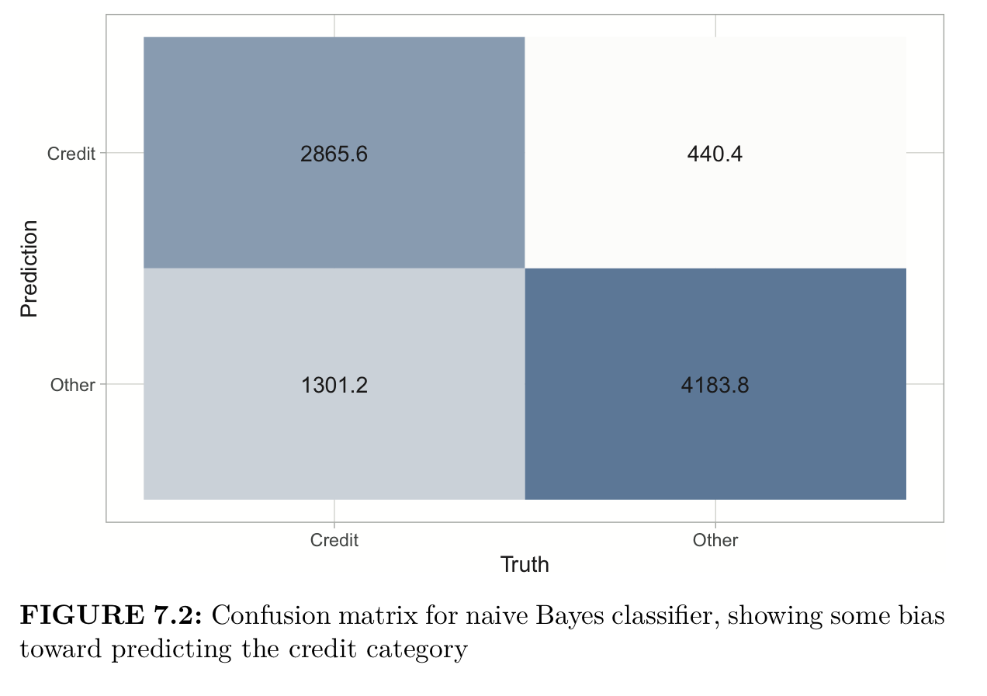
Evaluating Your Classification Model
You can evaluate your classification model in multiple ways.
As with a regression model, we want to preserve our test set to use at the end of our model training process to estimate performance on new data.
Instead, we will use the resampling methods to evaluate our model (e.g. a naïve Bayes classification model).
example, we can create a 10-fold cross validation set and use these resampled sets for performance estimates
Performance Estimates
Accuracy
The proportion of the data that is predicted correctly.
ROC AUC (Receiver Operator Characteristic Area Under the Curve)
Measures how well a classifier performs at different thresholds. The ROC curve plots the true positive rate against the false positive rate. An AUC closer to 1 indicates a better-performing model, while AUC closer to 0.5 indicates a model that does no better than random guessing.
Confusion Matrix
Tabulates a model’s false positives and false negatives for each class.

Slide 95
Exploring the NIST Cybersecurity RFI Corpus with Supervised ML Approaches
Predictive Classification Models
Predictive Regression Models

Slide 96
Tutorial on Advanced Text Analytics with NLP and GenAI
Agenda for the Tutorial: 1:00 – 4:00 p.m.
Welcome, Logistics, and Introductions (1:00-1:10)
Welcome and Logistics
Audience Introductions
Session I: Tutorial Overview/Dataset (1:10-1:15)
Text Mining in R and Python
NIST Cybersecurity RFI Corpus
Session II: Bag of Words Approaches (1:15-1:45)
Keyword and Phrase Frequency
Dictionaries and Sentiment Analysis
Session III: NLP-Syntactic Parsing and Unsupervised Machine Learning Approaches (1:45-2:15)
Named Entity Recognition
Topic Modeling
Coffee Break 2:15 – 2:45
Session IV: Supervised Machine Learning: Classification and Regression (2:45-3:15)
Predictive Models – Classification
Predictive Models – Regression
Session V: Generative AI and RAG (3:15-3:45)
Prompt Engineering
Notebook LM/AI Studio
Wrap-up, Discussion, Next Steps (3:45 – 4:00)
HICSS Community on Text Analytics

Slide 97
Session V: Generative AI (GenAI) and . Retrieval Augmented Generation (RAG)
HICSS-58 Tutorial
Tuesday, 7 January 2025 Room: Kona 4 1:00 – 4:00 p.m. HST

Slide 98
What is AI?
Source: https://medium.com/analytics-vidhya/ai-ml-dl-whats-what-ecb354967e63

Slide 99
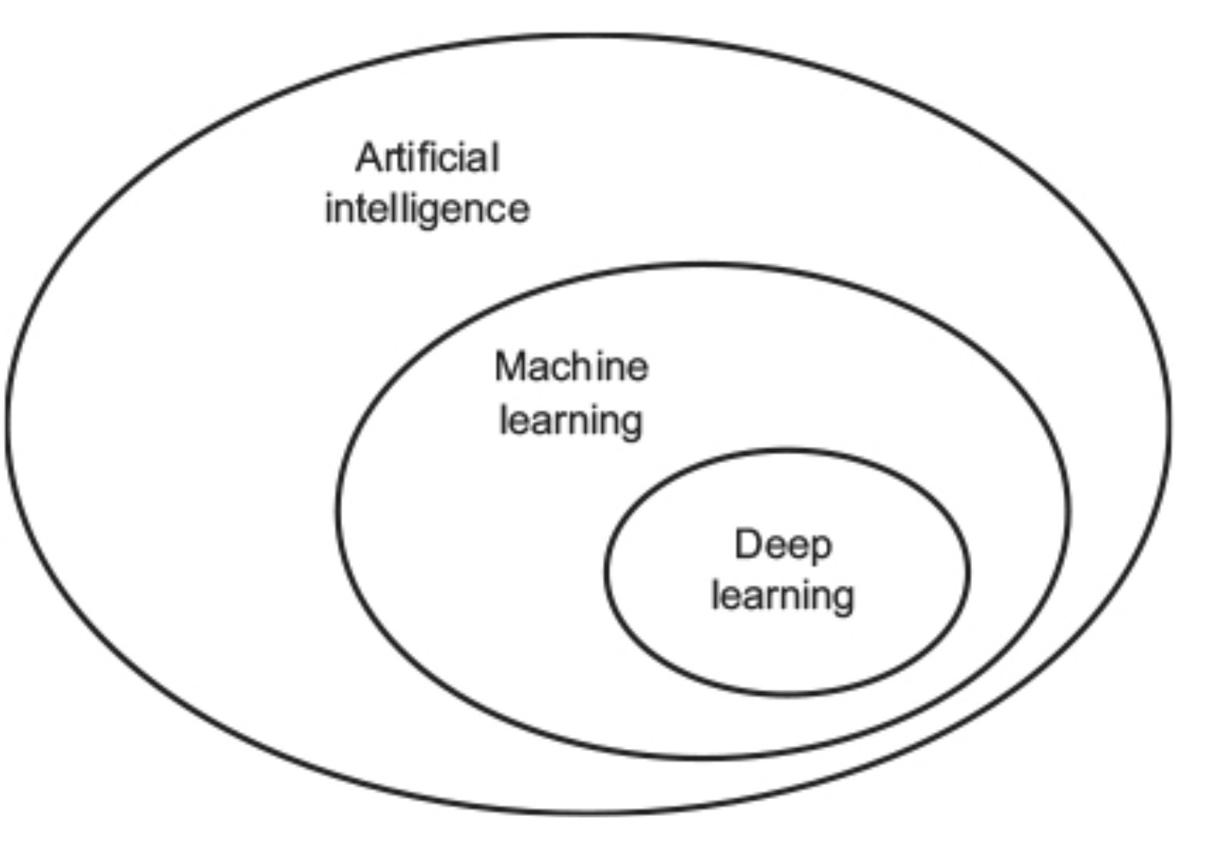
What is Deep Learning?
Artificial Intelligence (AI)
“The effort to automate intellectual tasks normally performed by humans”
Machine Learning (ML) is an extension of AI
Arises from a question: “Could a computer go beyond ’whatever we know how to order it to perform’ and learn on its own how to perform a specified task”?
Encapsulated in the Alan Turing’s 1950 proposal known as the “Turing Test”
Can a computer automatically learn rules by looking at data?
Two main approaches to ML
Unsupervised Machine Learning
Supervised Machine Learning
Traditionally these are “shallow” networks (only using one layer to train the ML model).
Deep Learning (DL) approaches take us to multiple layers, which is what makes Deep Learning “Deep”

Slide 100
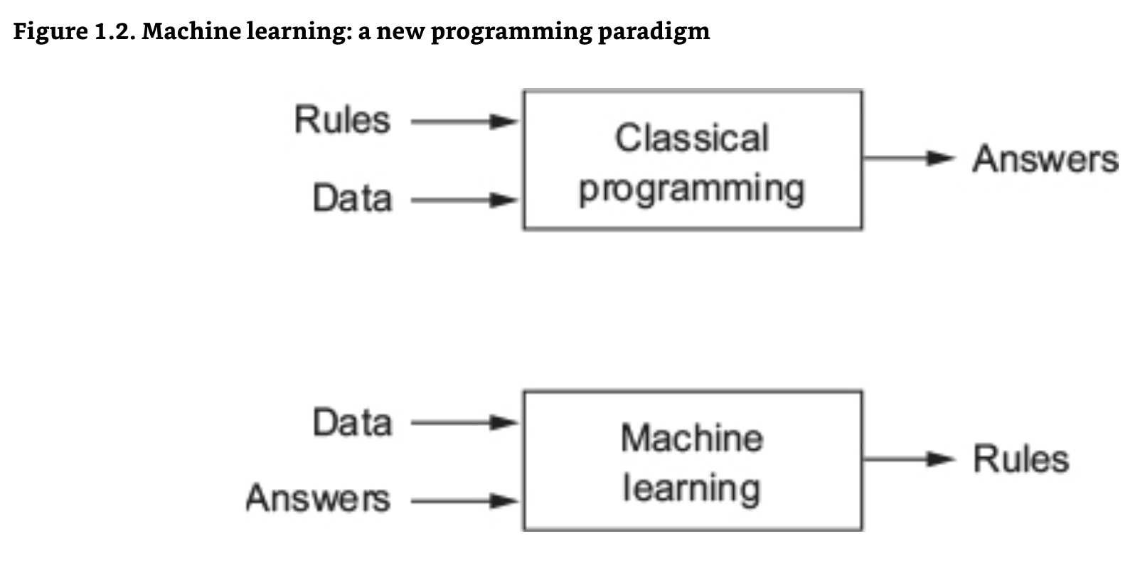
Machine Learning v. Classical Programming

Slide 101

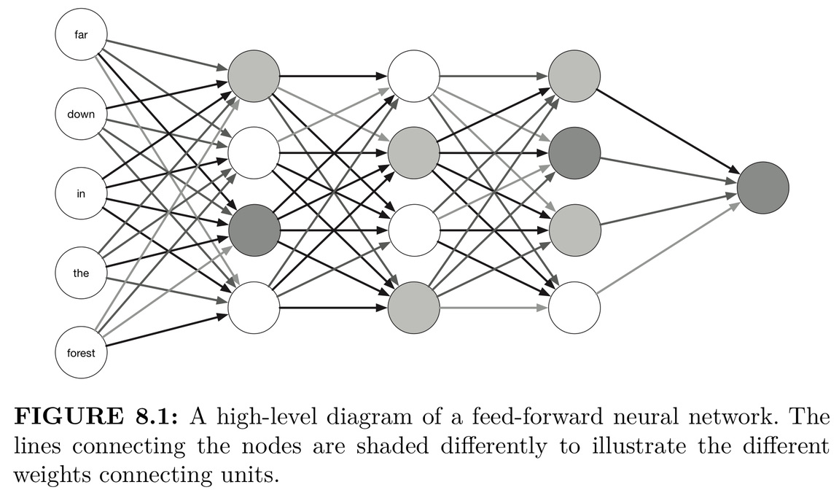
What is Deep Learning?
Like the previous supervised machine learning approaches, Deep Learning Methods predict outcomes from predictors of text or mostly text. Deep learning methods use different algorithms. What makes these methods “deep” is that they use multiple layers to map input features to outcomes. This is different from the “shallow” methods used previously.
Deep learning is seen as effective at text prediction because these “hidden”, deep, multiple layers are good for capturing the complexity of language. The model “learns” or reduces loss, as it automatically searches for better representations of the data
The layers in a deep learning model are connected in a network. These networks are called neural networks. They are connected in what are called network architectures (which sometimes incorporate word embeddings). Although they are called neural networks, they do not work like the human brain.
“Shallow” Network - one level
“Deep” Network - multiple levels
Preprocessed “Input” Data (text and other forms)
“Hidden Layers”
“Output”
As data moves through the network it becomes increasingly refined by the layers
”Neural” Networks – use multiple “nodes” (like neurons) in multiple network layers to process the input data and move it to predicting an output

Slide 102
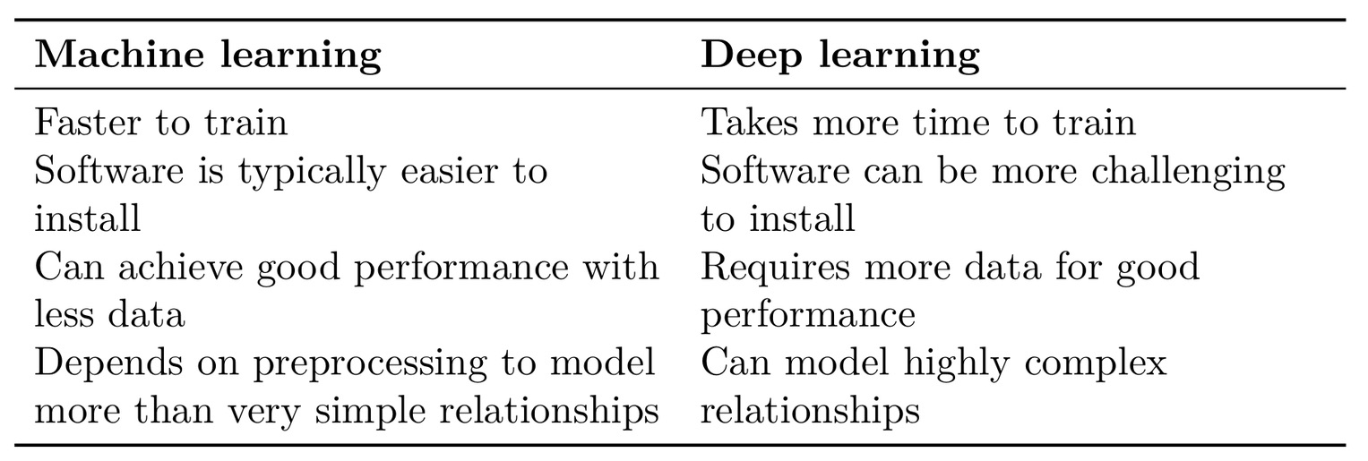
Comparing Machine Learning to Deep Learning

Slide 103
What is Deep Learning?
We will explore three important techniques:
We start with a densely connected neural network. Dense Neural Networks (DNNs) helping us to bridge between the “shallow” bag of words-based approaches and more complex network architectures.
Then we move to training and evaluating a long-short term memory (LSTM ) networks. They are among the most common architectures for text data. They model text as long sequences of words or characters.
Lastly, we move to CNN convolutional neural network. CNNS are good for text data because they can capture specific local patterns.
We will discuss and use Keras (framework for deep learning; creating and training many kinds of neural networks), Tensorflow, and tidymodels.

Slide 104
What is a Neural Network?

Slide 105
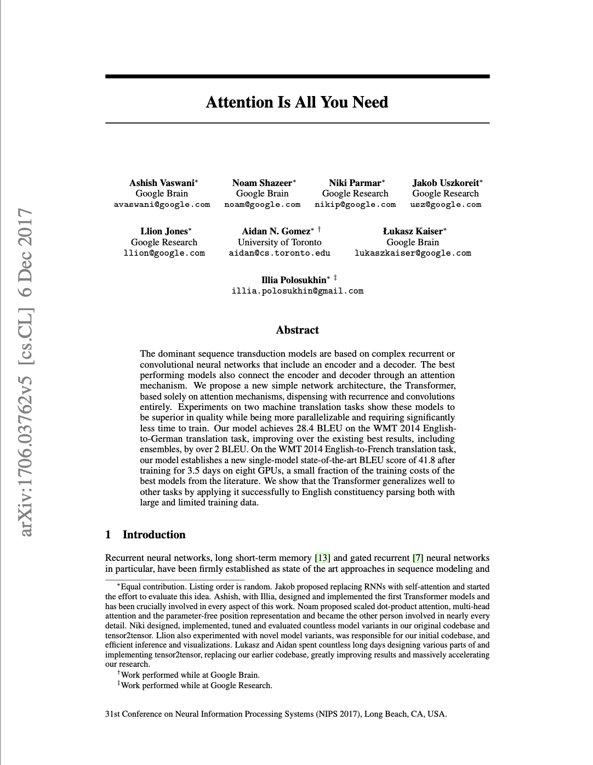
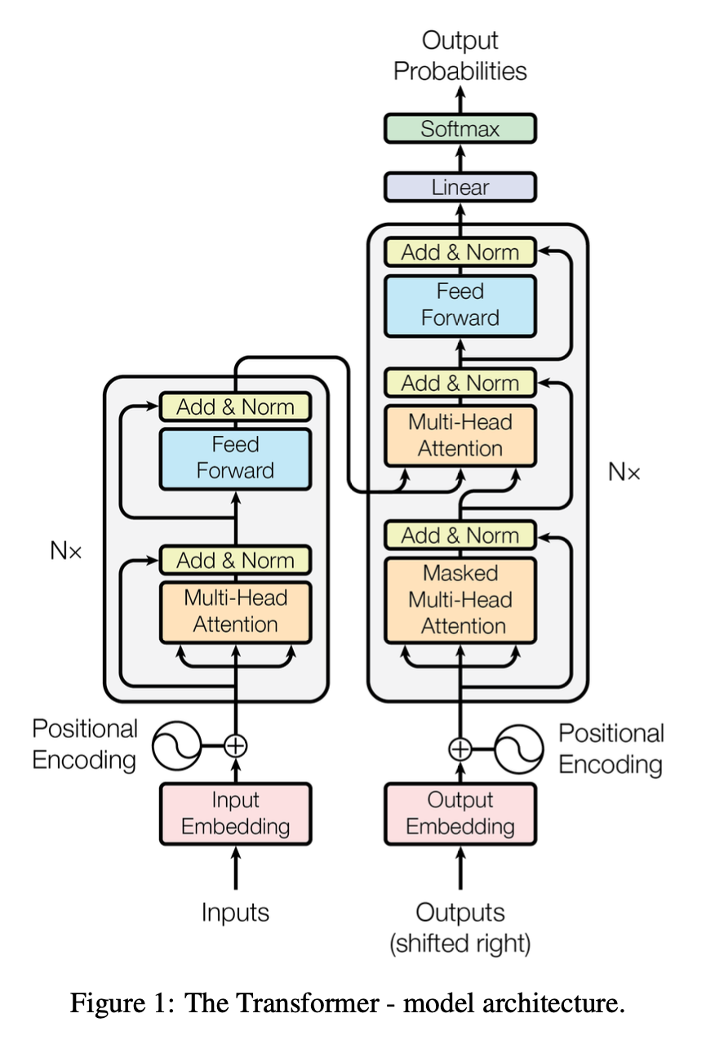
The Rise of the Transformer: Generative AI
A transformer is a deep learning model developed by Google researchers in 2017. It adopts the mechanism of “self-attention” and was introduced in an article called “Attention is All You Need.” They introduced Bidirectional Encoder Representations from Transformers (BERT) models.
Pre-training BERT from scratch is computationally expensive. Google has open sourced the pre-trained BERT model. It can be download from Google Research's GitHub repository.
These are the large language models or LLMs like GPT that have gained so much attention recently.
Your Prompt

Slide 106
The GenAI Juggernaut: ChatGPT
ChatGPT for many si synonymous with Generative AI
OpenAI provides both an API and numerous LLMs (4, 4o, 4o1)
Provides some of the best audio interface capabilities (including now a 1-800-ChatGPT)
Website, mobile app, integrated into multiple OS (e.g. MacOS, iOS, iPadOS)
Types of multimodal source documents
PDFs
URLs/web links
YouTube videos/comments,
Google Docs, slides, and sheets
A number of tools moving in this direction (NotebookLM and newer NotebookLlama)
https://chat.openai.com/

Slide 107
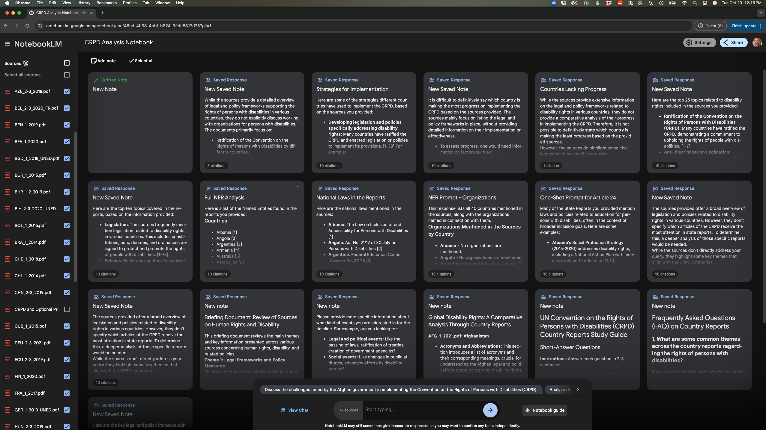
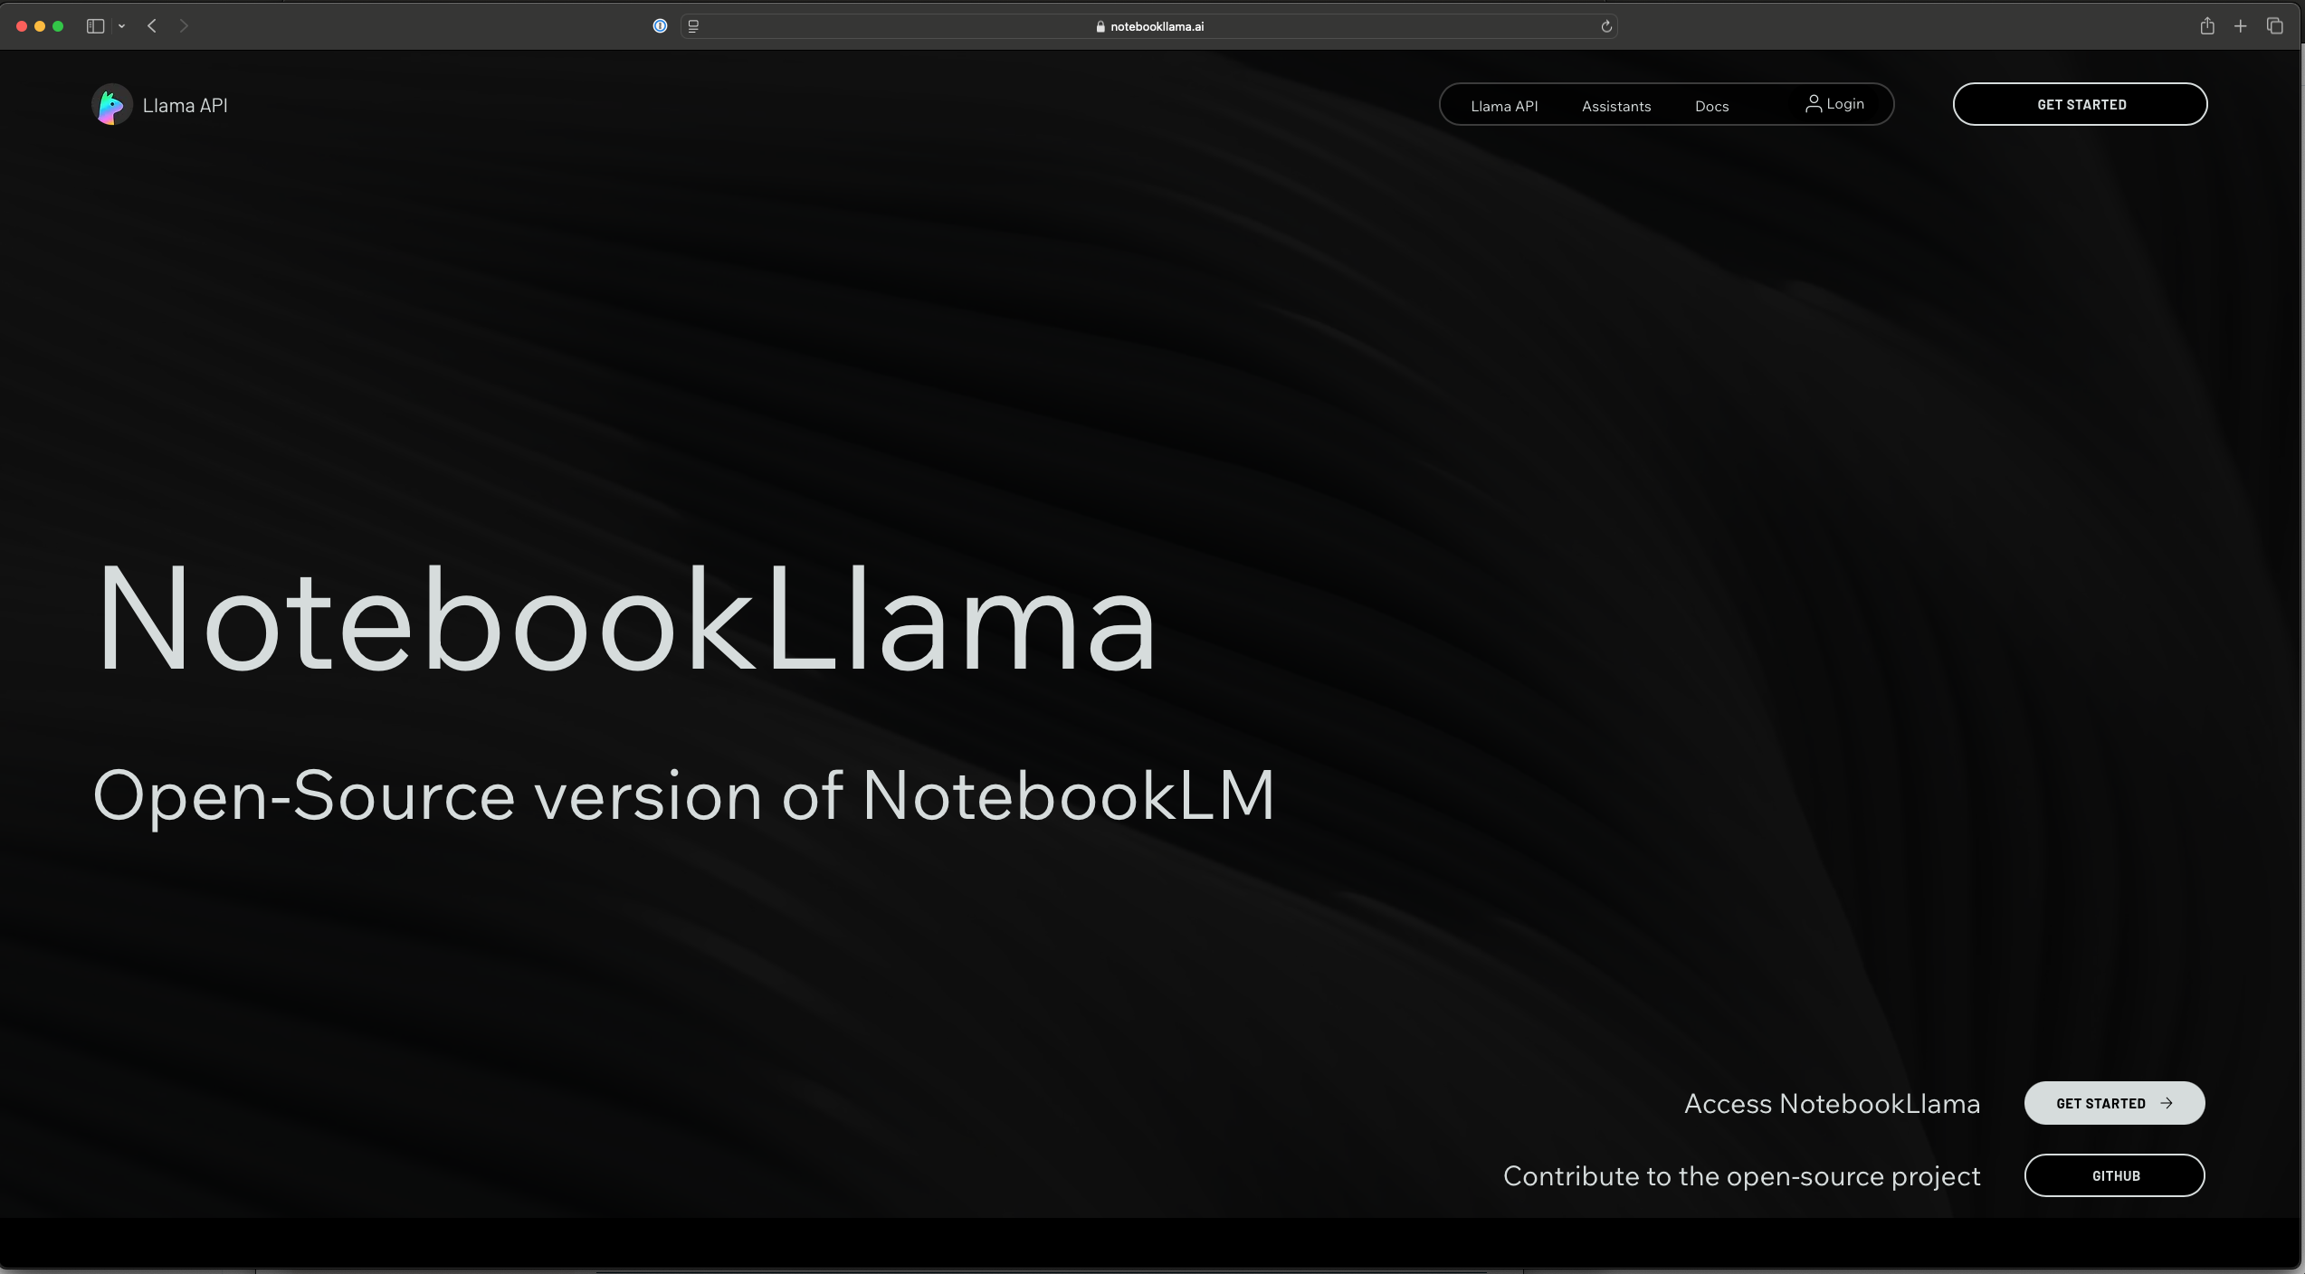
Introducing RAG Applications
RAG stands for Retrieval-Augmented Generation
Combines a retrieval system with an LLM
The goal is to produce more accurate and contextually relevant responses.
Using a range of target documents helps “ground” the LLM and reduce hallucinations
Types of multimodal source documents
PDFs
URLs/web links
YouTube videos/comments,
Google Docs, slides, and sheets
A number of tools moving in this direction (NotebookLM and newer NotebookLlama)
https://notebooklm.google.com/
https://www.notebookllama.ai

Slide 108
NotebookLM: Using RAG with an LLM
https://notebooklm.google.com/
Documents do not “leave” the notebook, are not used to train, or fine-tune this or other models
Autogenerated Content
FAQ
Study Guide
Deep Dive Podcast
Recommended Prompts
Can Export and Share Notebooks
Let’s review and then practice setting up a notebook in NotebookLM
https://www.notebookllama.ai

Slide 109


Another GUI Option: AI Studio
Another option is AI Studio (also by Google)
Provides access to Google’s Gemini LLMs (allows user to choose)
The Gemini (closed) and Gemma (open) family of models are multimodal, and can use text, images, and more in its analysis (Gemini 1.5 Pro 002, 1.5 Pro, 1.5 Flash, 1.5 Flash 002, 1.5 Flash-8B and Gemma 2 2B, 2 9B, 2 27B
User can also set the “temperature” of the model. In an LLM, temperature is a scale from 0-1+. This setting adjusts the level of randomness of responses. 1 is neutral, providing a “balanced” randomness; 0 most conservative and deterministic; 2 increase “creativity”, variability, and diversity
AI Studio is not designed solely as a RAG application, includes tools that allow for RAG
https://aistudio.google.com/
https://hicss.hawaii.edu

Slide 110
What is Prompt Engineering?
User Facing GUI
Input Text (Prompt): Writing instructions to get the best response from an LLM reflecting what we want.
Two types of LLMs
Base LLM (Predicts next word based on training data)
Instruction Tuned LLM (Fine-tuned on instructions. Tries to follow instructions, uses Reinforcement Learning From Human Feedback (RLHF) – attempt to be “Helpful, Honest, Harmless”); ”temperature adjusted” models
Three types of Prompts
Zero-Shot: Input text does not include examples.
One-Shot: Input text includes one example.
Few-Shot: Input text includes several examples.
LLM Backend
Your Prompt
Notes:
No easy task; multiple definitions and considerations (e.g. what is intelligence).

Slide 111
The Art and Science of Prompt Engineering
Key principles and best practices of prompting
1. Write clear and specific instructions
Be clear about on what you want the LLM to focus
Specify the “tone” you want the LLM to take
What “persona” and any specifics for it to consider
Do not confuse writing clear prompts with writing short
Use delimiters (e.g “””) “Summarize the text delimited by triple backticks into a single sentence”
2. Give the LLM time to think
http://deeplearning.ai
Notes:
No easy task; multiple definitions and considerations (e.g. what is intelligence).

Slide 112
The Art and Science of Prompt Engineering
Prompt Transformation
When either the end-user or the developer of an LLM takes a prompt (input text) and transforms it to make the model perform better.
Prompt Injection
When either the end-user or the developer of an LLM inserts into a prompt, text designed to change how the model behaves or to override safeguards built into the model.
Your Prompt
Notes:
No easy task; multiple definitions and considerations (e.g. what is intelligence).

Slide 113
Exploring the NIST Cybersecurity RFI Corpus with Generative AI Approaches
ChatGPT (GenAI)
Claude (GenAI)
NotebookLM (RAGAI)

Slide 114

ChatGPT - Methods
Methodology
Uploaded CSV file with all responses and metadata
Began with initial prompts to describe the data, variables, etc.
Then began prompting to answer common research questions starting with initial inductive questions and moving to more detailed deductive questions.

Slide 115

ChatGPT-Findings
20 Frequent Words (with/without stopwords removed)
20 Frequent Words/TFIDF
20 Most Frequent Phrases
Top 10 Words by Category
Top 10 Phrases by Category
Ten most important topics
Words associated with topics
Named entities
What words predict categories

Slide 116





Claude - Methods
Code for Initial Analysis
Methodology
Uploaded CSV file with all responses and metadata and a simple initial prompt.
With no additional prompting, Claude provided an outstanding overview of the data. NB: It also provided the code it used to complete the initial analysis.
Then began prompting to answer common research questions starting with initial inductive questions and moving to more detailed deductive questions.
Offer to Follow-Up
Initial Prompt
Initial Response
Created Interactive Data Visualization

Slide 117



Claude-Findings
Code to Analyze Top Words
20 Frequent Words (with/ without stopwords removed)
20 Frequent Words/TFIDF
20 Most Frequent Phrases
Top 10 Words by Category
Top 10 Phrases by Category
Ten most important topics
Words associated with topics
Named entities
What words predict categories
Top Words
Interactive Visualization

Slide 118



Claude-Findings
Code to Analyze N-Grams
20 Frequent Words (with/ without stopwords removed)
20 Frequent Words/TFIDF
20 Most Frequent Phrases
Top 10 Words by Category
Top 10 Phrases by Category
Ten most important topics
Words associated with topics
Named entities
What words predict categories
Interactive Visualization
N-Gram Analysis

Slide 119



Claude-Findings
Code to Analyze Category Prediction
20 Frequent Words (with/ without stopwords removed)
20 Frequent Words/TFIDF
20 Most Frequent Phrases
Top 10 Words by Category
Top 10 Phrases by Category
Ten most important topics
Words associated with topics
Named entities
What words predict categories
Interactive Visualization
What Words Predict Category

Slide 120

Claude-Findings
20 Frequent Words (with/ without stopwords removed)
20 Frequent Words/TFIDF
20 Most Frequent Phrases
Top 10 Words by Category
Top 10 Phrases by Category
Ten most important topics
Words associated with topics
Named entities
What words predict categories
Prompt about language choice and response

Slide 121
NotebookLM - Methods
Methodology
Took all the RFI responses from 2021 (n=120)
To get down to the 50-document limit for NotebookLM
Removed all submissions from individuals, anonymous, purposively selected submissions
Uploaded final 50 documents to a project in NotebookLM
Began with an initial Audio Overview, using all defaults. Created a 17 minute two-person overview with multiple sections.
Then, used Interactive Mode to correct the AI-generated focus (from “stack of papers” to responses to the NIST RFI on AI RMF
Then, created: Briefing Note, Study Guide, FAQ, Timeline
Finally, I started asking various research questions starting with initial inductive questions and moving to more detailed deductive questions.

Slide 122

NotebookLM-Methods
20 Frequent Words (with/without stopwords removed)
20 Frequent Words/TFIDF
20 Most Frequent Phrases
Top 10 Words by Category
Top 10 Phrases by Category
Ten most important topics
Words associated with topics
Named entities
What words predict categories

Slide 123



NotebookLM-Findings
20 Frequent Words (with/without stopwords removed)
20 Frequent Words/TFIDF
20 Most Frequent Phrases
Top 10 Words by Category
Top 10 Phrases by Category
Ten most important topics
Words associated with topics
Named entities
What words predict categories
Frequent Words
Frequent Phrases
Top 10 Topics (LDA Approximation)

Slide 124



NotebookLM-Findings
20 Frequent Words (with/without stopwords removed)
20 Frequent Words/TFIDF
20 Most Frequent Phrases
Top 10 Words by Category
Top 10 Phrases by Category
Ten most important topics
Words associated with topics
Named entities
What words predict categories
Named Entities:
Organizations
Named Entities: People
Named Entities:
Standards and Frameworks

Slide 125



NotebookLM-Findings
20 Frequent Words (with/without stopwords removed)
20 Frequent Words/TFIDF
20 Most Frequent Phrases
Top 10 Words by Category
Top 10 Phrases by Category
Ten most important topics
Words associated with topics
Named entities
What words predict categories
Recommendations for Implementing the AI RMF
Categorization of Entities Submitting to the AI RMF
Similarities and Differences in
Submissions by Category

Slide 126
Tutorial on Advanced Text Analytics with NLP and GenAI
Agenda for the Tutorial: 1:00 – 4:00 p.m.
Welcome, Logistics, and Introductions (1:00-1:10)
Welcome and Logistics
Audience Introductions
Session I: Tutorial Overview/Dataset (1:10-1:15)
Text Mining in R and Python
NIST Cybersecurity RFI Corpus
Session II: Bag of Words Approaches (1:15-1:45)
Keyword and Phrase Frequency
Dictionaries and Sentiment Analysis
Session III: NLP-Syntactic Parsing and Unsupervised Machine Learning Approaches (1:45-2:15)
Named Entity Recognition
Topic Modeling
Coffee Break 2:15 – 2:45
Session IV: Supervised Machine Learning: Classification and Regression (2:45-3:15)
Predictive Models – Classification
Predictive Models – Regression
Session V: Generative AI and RAG (3:15-3:45)
Prompt Engineering
Notebook LM/AI Studio
Wrap-up, Discussion, Next Steps (3:45 – 4:00)
HICSS Community on Text Analytics

Slide 127
Wrap-Up, Discussion, and Next Steps .
HICSS-58 Tutorial
Tuesday, 7 January 2025 Room: Kona 4 1:00 – 4:00 p.m. HST

Slide 128
Open Discussion: HICSS and Text Analytics
HICSS Fast Track Publication Opportunity
Data & Policy, Cambridge University Press
https://www.cambridge.org/core/journals/data-and-policy
Contact: Derrick Cogburn (dcogburn@american.edu)
Building a HICSS Text Analytics Community
Private hicss-text-analytics GitHub repository established, with Quarto documents, Jupyter Notebooks, and data
https://github.com/derrickcogburn/hicss-text-analytics
Should we establish a mailing list, Slack, Discord?
HICSS-58 Minitracks
Culture, Identity, and Inclusion
Wednesday, 10:00 a.m. – 3:30 p.m.
AI Safety, Cybersecurity, and Inclusion Through Advanced Text Analytics
Thursday, 10:00 a.m. – 11:30 p.m.
HICSS-59 (Maui, 6-9 January 2026: Hyatt Regency Maui)
Tutorial on Text Mining (full day, two half-days (intro/intermediate)
Minitrack on Text Mining (reviewers and paper authors)

